Slide 1
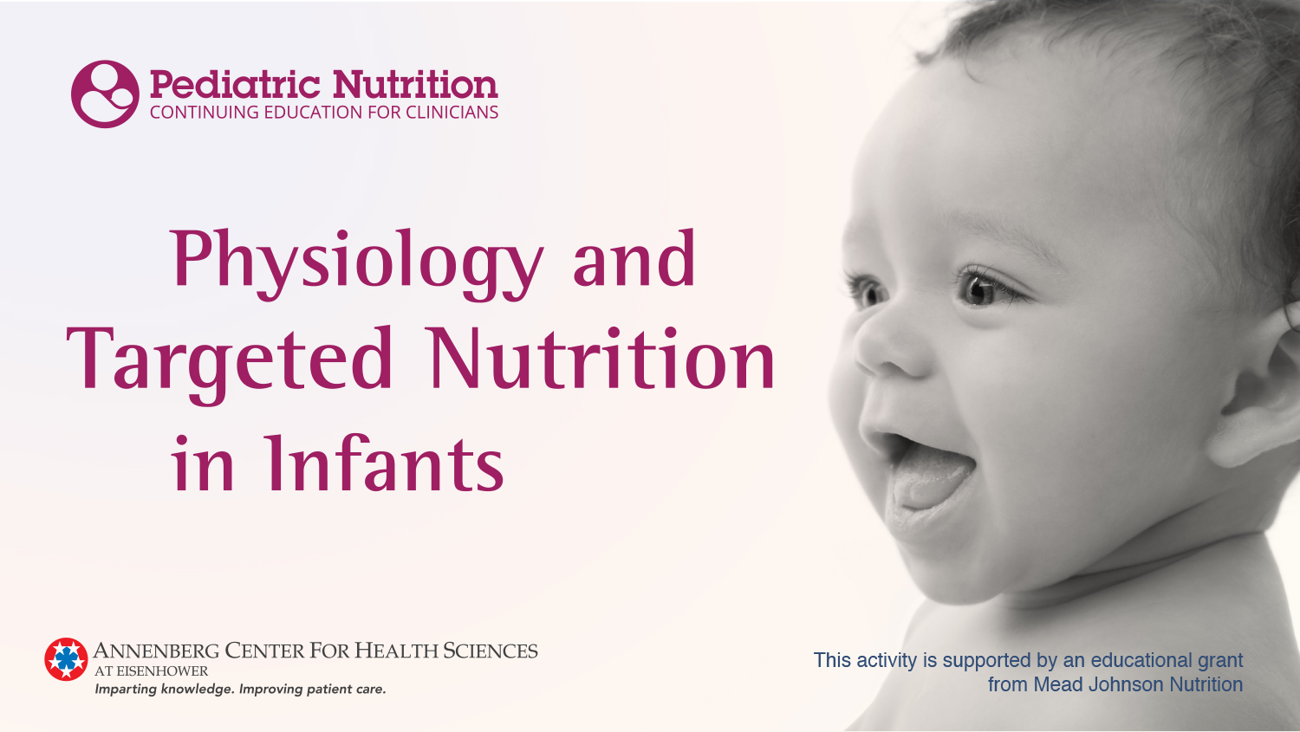
Replace with title slide

Slide 2
Presenters
Michael K. Georgieff, MD
Professor of Pediatrics and Child Development
University of Minnesota School of Medicine
Director, Center for Neurobehavioral Development
The University of Minnesota Masonic Children’s Hospital
Minneapolis, Minnesota
Camilia R. Martin, MD, MS
Associate Professor of Pediatrics
Harvard Medical School
Associate Director, NICU Department of Neonatology
Director for Cross-Disciplinary Research Partnerships
Division of Translational Research
Beth Israel Deaconess Medical Center
Boston, Massachusetts

Slide 3
Disclosures
Michael K. Georgieff, MD
No relationships to disclose
Camilia R. Martin, MD, MS
Research Support | Abbott Nutrition, Alcresta Therapeutics
Consultant | Fresenius Kabi
Scientific Advisory Board | Laurent Pharmaceuticals, Prolacta Bioscience

Slide 4
Learning Objectives
Evaluate how targeted nutrition impacts physiological development
Apply evidence-based nutrient research to disease risk and long-term development in preterm and term infants
Recognize the role of nutrition in early brain development to improve postnatal outcomes

Slide 5
Introduction

Slide 6
Rigor and Reproducibility in Science Nutrition Research
¹
²
³
⁴
1. Kroeger CM, et al. Am J Clin Nutr. 2018;107(3):484-494. 2. Garza C, et al. Am J Clin Nutr. 2019;109(1):225-243. 3. Ioannidis JPA. JAMA. 2018;320(10):969-970. 4. Wood AC, Wren JD, Allison DB. JAMA Pediatr. 2019.

Slide 7
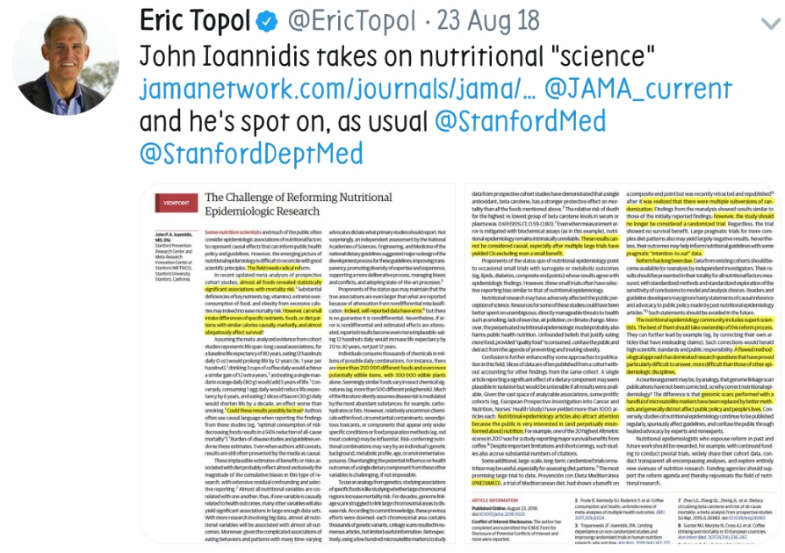
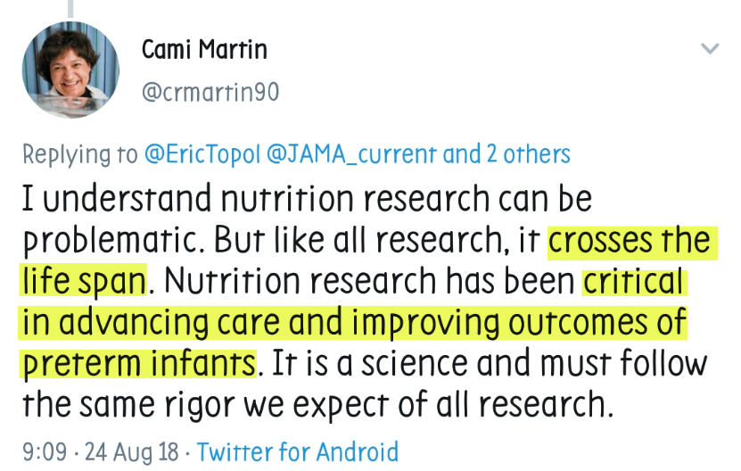
Rigor and Reproducibility in Science Nutrition Research

Slide 8
Neonatal Nutrition: Unique Opportunity to Reveal Nutrient-Directed Effects on Human Physiology
The calls for increased rigor and reproducibility
Should not detract from the evidence supporting the role of nutrition in improving survival and outcomes in preterm infants; a unique population that is captive, with limited exogenous exposures, and is in a rapidly developing window
Should not lead to assumptions that adult physiological response to nutrition/nutrients is the same as the neonate
Neonatal response to nutrition is unique and has a fundamental role in developmental physiology impacting health and disease risk
It is imperative that all aspects of nutrition—practice and substrate delivery—be thoroughly investigated given the profound impact on health in the immediate and in the long term

Slide 9
Developmental Origins
Developmental perspective on risk for adult disease
The “Barker Hypothesis”  “Fetal Origins”  DOHaD
Early life events affect relevant long-term health outcomes
Cardiovascular
Metabolic
Immunologic and allergic
Cancer
Mental Health
Potential biological mechanisms of the long-term neurobehavioral effects
Clinical implications
DOHaD, Developmental Origins of Health and Disease.

Slide 10
Early Events and Later Outcomes
Development is based on
Genetics
Epigenetics (experience-dependent influences)
All organs, especially the brain, grow rapidly in late fetal/early neonatal period
Highly vulnerable to insults
Demonstrates its greatest plasticity/resilience and response to therapy

Slide 11
Fetal Programming
“Programming” refers to epigenetic process
Early environmental stimuli (eg, nutrition) alter how genes are expressed throughout the lifetime
Best described in fetal period with effect of prenatal nutrition  adult cardiovascular health (D. Barker)
May also apply to postnatal nutrition in
Term and preterm infants
Adopted, orphaned children
Foster children
Children after severe illness
Suggests vulnerable period based on postconceptional age irrespective of in utero vs ex utero (ie, no longer ‘fetal’)

Slide 12
What is the Barker Hypothesis?
Studies by David Barker’s group
Cohorts of adults in Britain with heart disease, diabetes mellitus, hypertension
Risk related, in part, to birth weight
Lower birth weight (ie, <7.0 lbs) increased risk
Concept of altered metabolic set points in utero
Altered hypothalamic/pituitary/adrenal axis regulation (stress hormones)
Altered hepatic metabolism (especially carbohydrate handling)
Activation of proinflammatory cytokines
Barker DJ. BMJ. 1995;311:171-4.

Slide 13
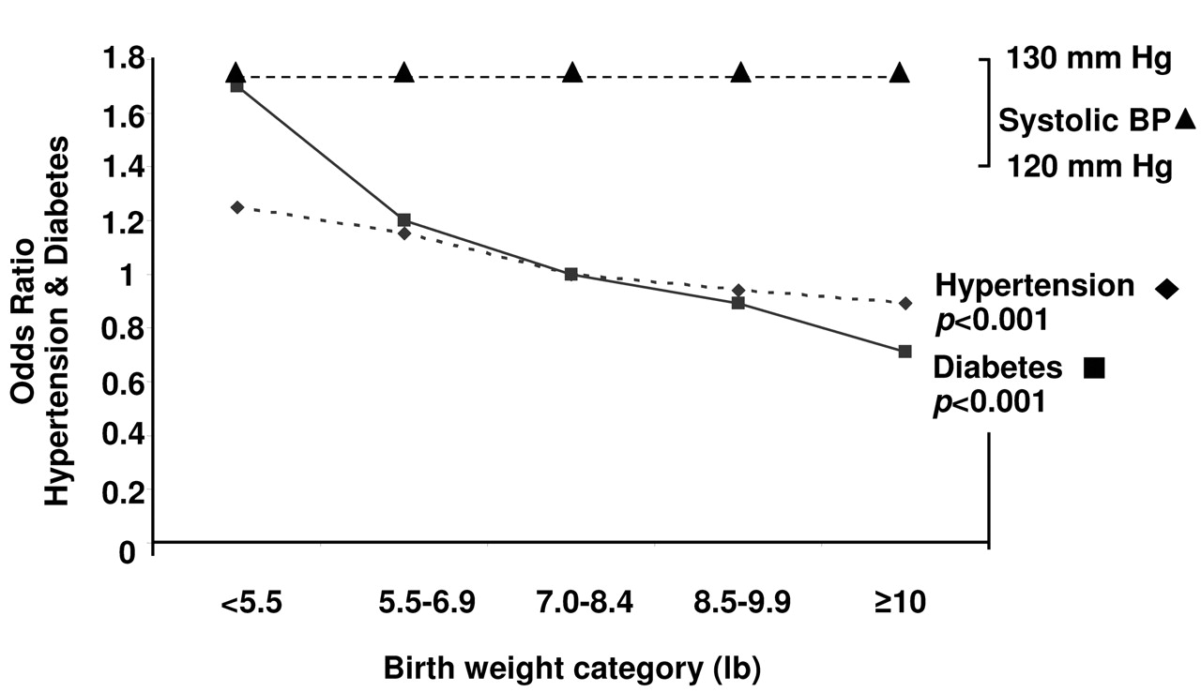
Curhan GC, et al. Circulation. 1996;94:3246-50. Gluckman PD, Hanson MA. Science. 2004;305:1733-1736. Used with permission from The American Association for the Advancement of Science.

Slide 14
Nutritional Programming in the Early Postnatal Period and Risk of Neonatal Morbidities

Slide 15
Nutrient-Directed Effects on Human Physiology
Adult Viewpoint
The potential to modulate the activity of the immune system by interventions with specific individual nutrients is termed immunonutrition.†
Infant Viewpoint
In the developing neonate, complex diets, medical practices, and individual nutrients have the potential to modulate the activity of the immune system, inflammation, and organogenesis—nutritional programming.
†Calder PC. BMJ. 2003; 327:117–118.

Slide 16
“…human infants actually remain helpless longer than infants of any other species and, …must also go through a distinct period of gestation outside of the womb.”
“This period of exterior gestation needs to be respected not just as a sentimental matter, but as one that has a profound and major impact on an infant’s physical, emotional, and psychological development.”
–Elizabeth Antunovic
Antunovic E. The Second Nine Months: Exterogestation and the Need to be Held. Boba. August 2018. http://www.boba.com/the-second-nine-months
Photo Credit: kipgodi/Bigstock

Slide 17
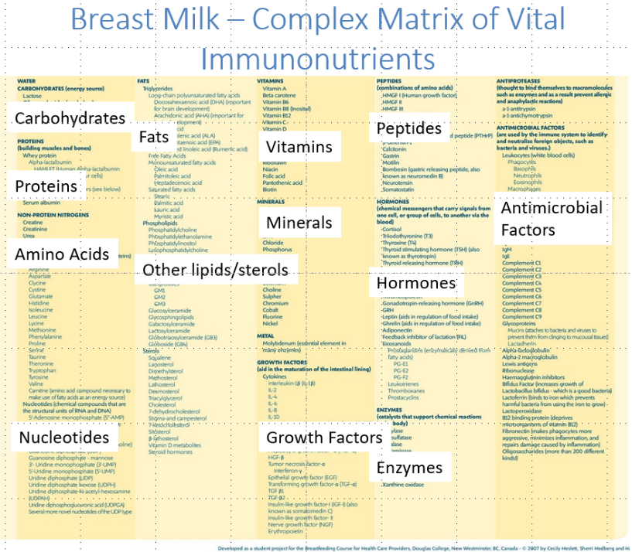
In Utero to Ex Utero Transition
Modified from Cho CK, et al. Mol Cell Proteomics. 2007;6:1406-15.
Modified from image developed as a student project for the Breastfeeding Course for Health Care Providers, Douglas College, New Westminster, BC, Canada © 2007 by Cecily Heslett, Sherri Hedberg and Haley Rumble.

Slide 18
Mom’s milk (nutrition) is critical in this period of exterior gestation.
Even more true for our preterm infants who still have to complete their first gestation!
Photo Credits: (Top) Romanova Anna/Bigstock, (Bottom) Metin Kiyak/Getty Images

Slide 19
Protection
Development
Independence
During exterior gestation Mom’s milk/nutrition provides necessary bioactive components to protect the infant from adverse environmental influences (as the infant is not ready to protect itself) while continuing the biological signaling for optimal organ development and ultimately healthy independence.

Slide 20
General Nutritional Delivery and Neonatal Outcomes
Early Nutrition Mediates the Influence of Severity of Illness on Extremely Low-Birth-Weight Infants¹
First 7 days, OR of NEC, late-onset sepsis, BPD, and NDI decreased by ~2% for each 1 kcal/ kg/d of total energy intake
First-Week Protein and Energy Intakes Are Associated With 18-Month Developmental Outcomes in Extremely Low-Birth-Weight Infants²
An increase of 42 kJ (10 kcal)/kg per day independently associated with a ~5-point increase in MDI
An increase of 1 g/kg per day of protein independently associated with a ~8-point increase in MDI
Early Energy and Protein Intakes and Associations With Growth, BPD, and ROP in Extremely Preterm Infants³
Every 10 kcal/kg/d associated with 0.08 higher weight SD score
Between d7-27, every 10 kcal/kg/d reduced risk of BPD of 9% and any grade of ROP of 6%
Interaction MV, energy, protein: mean energy intake of 120 kcal/kg/d, every 0.5 g/kg/d reduced risk of BPD by 25%
BPD, bronchopulmonary dysplasia; MDI, mental developmental index; NDI, neurodevelopmental impairment; NEC, necrotizing enterocolitis; ROP, retinopathy of prematurity.
1. Ehrenkranz RA, et al. Pediatr Res. 2011;69:522-9. 2. Stephens BE, et al. Pediatrics. 2009;123:1337-43. 3. Klevebro S, et al. Clin Nutr. 2018. pii: S0261-5614:30197-3.

Slide 21
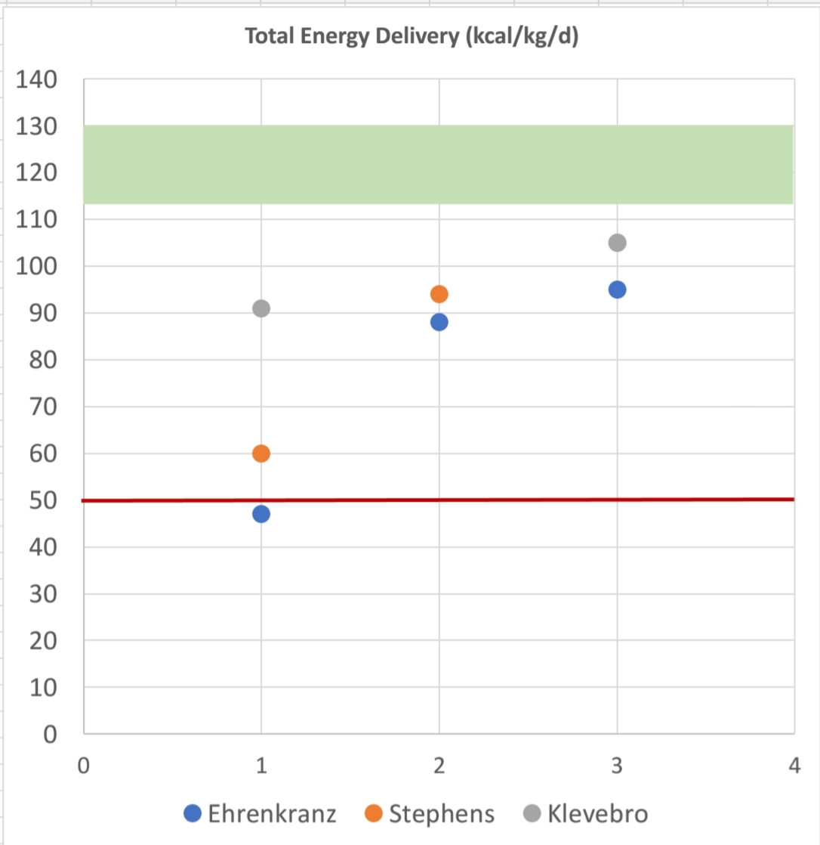
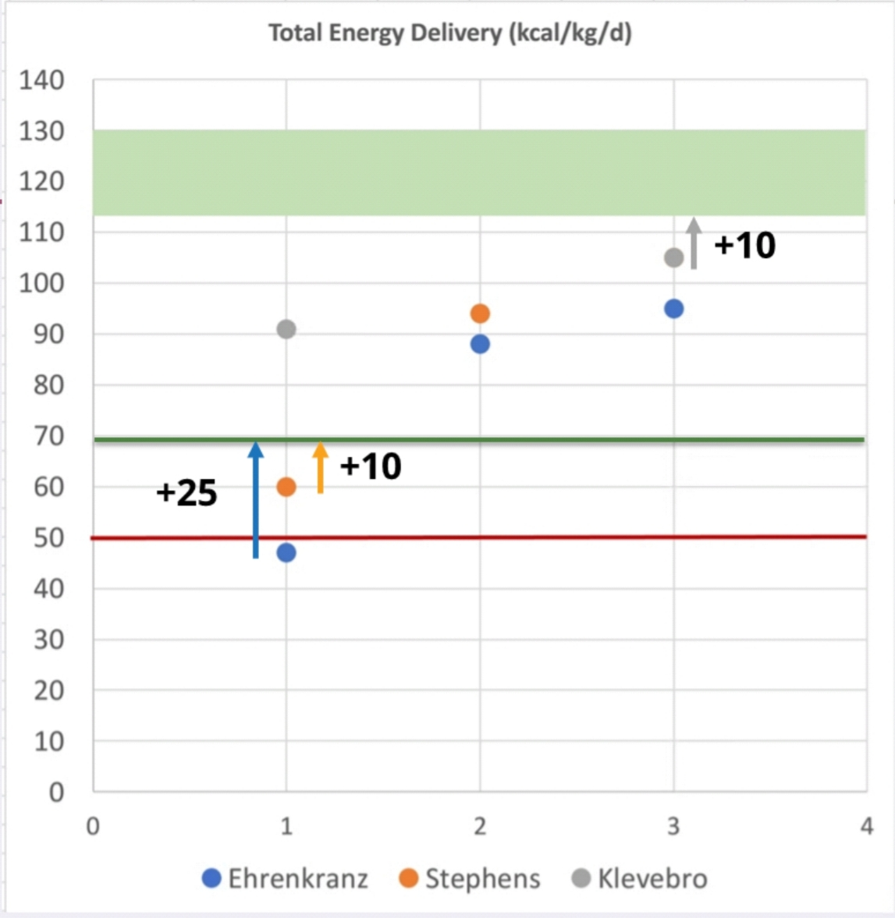
General Nutritional Delivery and Neonatal Outcomes
Target energy delivery in first week of 70 kcal/kg/d, increasing to 115-130 average over first few weeks
Protein delivery target starting at 3, increments to 4 g/kg/d
Lipid delivery target starting 2-3 to goal of 3.0 g/kg/d
Koletzko, Poindexter, and Uauy. Nutritional Care of Preterm Infants: Scientific Basis and Practical Guidelines. S. Karger AG, 2014

Slide 22
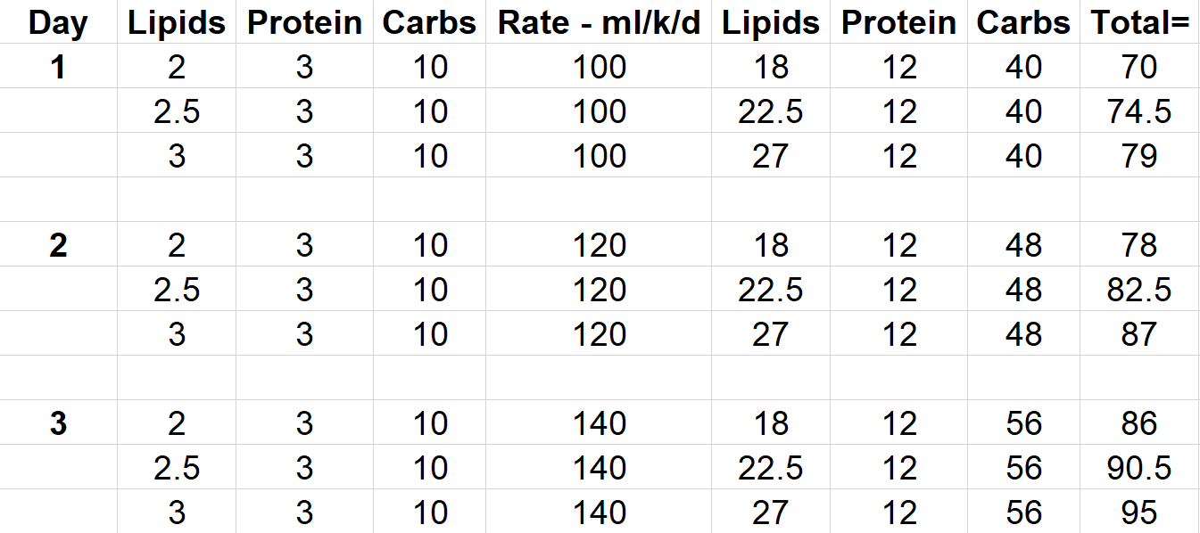
General Nutritional Delivery and Neonatal Outcomes (continued)
Koletzko B, Poindexter B, Uauy R (Editors). Nutritional Care of Preterm Infants: Scientific Basis and Practical Guidelines. Basel, Karger, 2014.

Slide 23
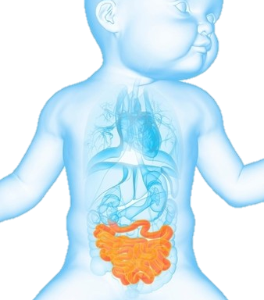
Intestinal Tract: The Largest Immune Organ and Defense Barrier
Direct exposure to nutrients
Largest immune organ and defense barrier
Gut-systemic health axis
Image Credit: Sebastian Kaulitzki/Science Source

Slide 24
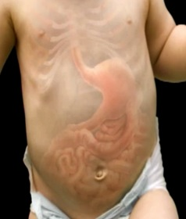
Dysbiosis and Neonatal Mortality
Necrotizing Enterocolitis
Commensal Bacteria
Pathogenic Bacteria
Chronic Lung Disease
Altered Immune Ontogeny
Dysregulated Inflammation
Impaired Organogenesis
Sepsis

Slide 25
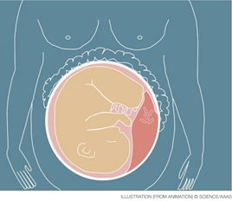
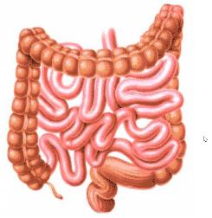
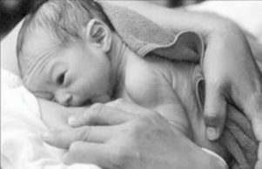
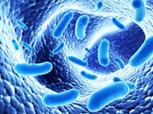
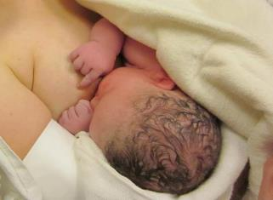
Influences on Postnatal Gut Development
Maternal/Fetal Microbiome
and Vaginal Delivery
Cesarean Section
Hospitalization
Skin-to-Skin
Medications
Delayed Feedings/Formula
Limited MM/DM
Breastfeeding
DM, donor milk; MM, mother’s milk.

Slide 26
Breast Milk Increases Intestinal Barrier Function Compared to Formula
L/M, lactulose to mannitol.
Taylor SN, et al. Breastfeed Med. 2009;4:11-5. Used with permission from Mary Ann Liebert, Inc.

Slide 27
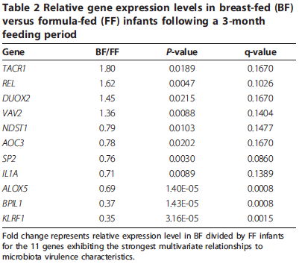
Influence of Diet on Intestinal Gene Expression
Formula:
Lower phylogenetic heterogeneity (and decreased diversity) of the microbiome
Lower overall gene expression by the intestinal epithelium
Breastfeeding
Gut motility, bacterial-mediated reactive oxygen species signaling,
epithelial homeostasis
Mucosal inflammatory responses, permeability-increasing, vascular adhesion
RNA-seq on host RNA from shed intestinal cells in fecal samples.
Schwartz S, et al. Genome Biol. 2012;13:r32. Used under terms of a Creative Commons License.

Slide 28
Human Milk Oligosaccharides
Diverse unconjugated glycans
Abundant in and unique to human milk
More than a hundred different HMOs have been identified
Not every woman synthesizes the same set of oligosaccharides
HMOs reach the distal small intestine and colon in an intact form and are excreted with the infant’s feces¹
Human Milk Comparison²
HMOs, human milk oligosaccharides.
1. Bode L. Glycobiology. 2012;22:1147-62.
2. Zivkovic AM, et al. Proc Natl Acad Sci USA. 2011;108 Suppl 1:4653-8. © 2011 National Academy of Sciences. Used under terms for educational purpose.

Slide 29
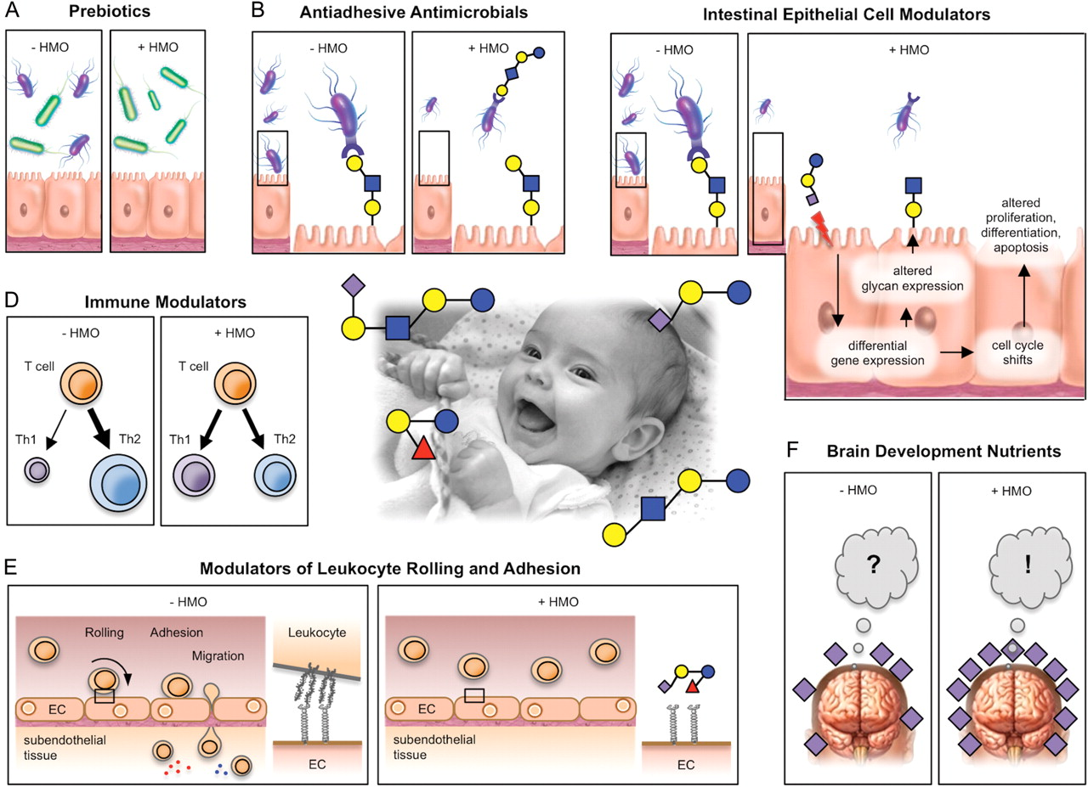
Pleiotropic Effects of Human Milk Oligosaccharides
Bode L. Glycobiology. 2012;22:1147-62. Used with permission from Oxford University Press.

Slide 30
Nutrition Practices
Delayed feedings/Formula
Limited MM/DM
Early = initial enteral feeding at the third postnatal day or less; Late = initial enteral feeding after the third postnatal day.
Konnikova Y, et al. PLOS One. 2015;10:e0132924. Used under terms of a Creative Commons License.

Slide 31
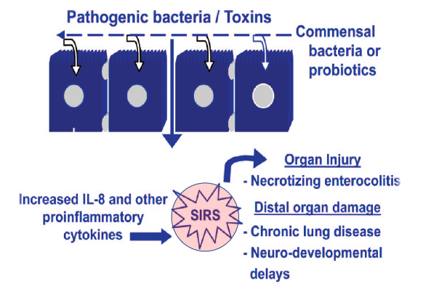
Evidence for Gut to Systemic Health Link
Delayed feedings after 3 days leads to detectable inflammation at 2 weeks postnatal age and increased risk of CLD at 36 weeks PMA¹
Intestinal injury leads to sustained systemic inflammatory response; sustained systemic inflammatory response leads to poor neurocognitive outcomes, as does NEC^{2,3}
NEC a common node in clustering of neonatal morbidities⁴
Humanized gnotobiotic mice with preterm microbiota results in dysregulated systemic inflammation and altered growth⁵
CLD, chronic lung disease; NEC, necrotizing enterocolitis; PMA, postmenstrual age; SIRS, systemic inflammatory response syndrome.
1. Konnikova Y, et al. PLOS One. 2015;10:e0132924. 2. O’Shea TM, et al. J Pediatr. 2012;160(3):395-401.e4. 3. Carlo WA, et al. J Pediatr 2011;159:919-25.e3. 4. Leviton A, et al. Acta Paediatr. 2010;99:1795-800. 5. Lu L, et al. PLOS One. 2015;10:e0124504.

Slide 32
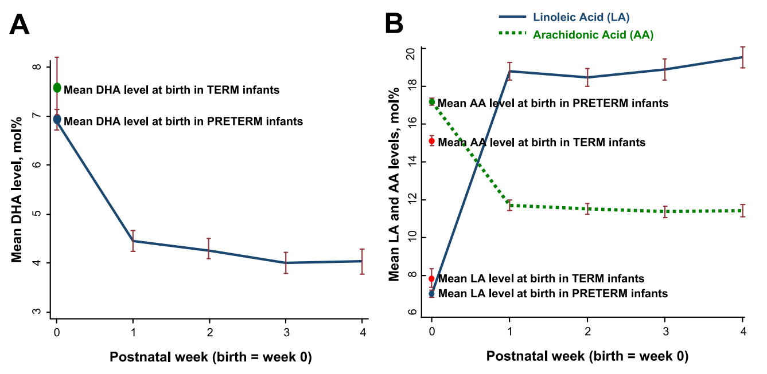
Nutrient-Specific Postnatal Transitions in the Preterm Infant Case Study: Long-Chain Polyunsaturated Fatty Acids
DHA, docosahexaenoic acid.
Martin CR, et al. J Pediatr. 2011;159:743-749.e1-2.

Slide 33
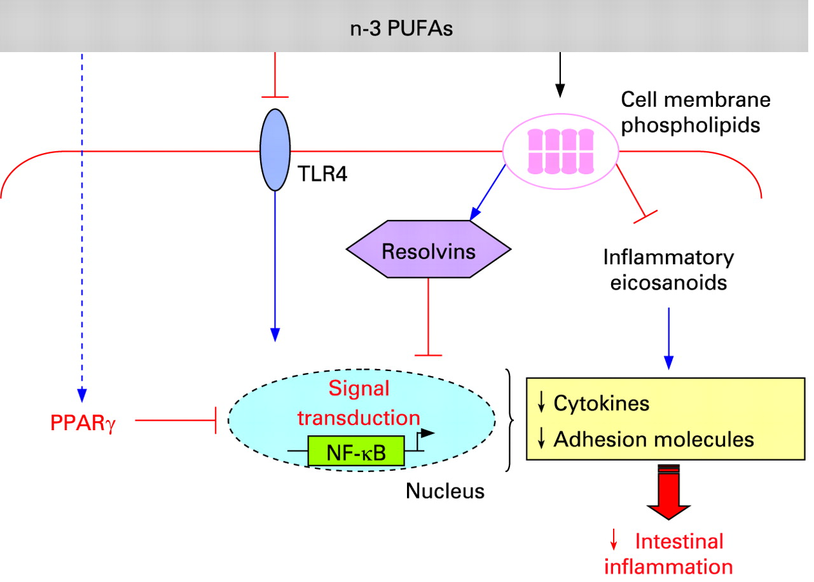
n-3 PUFAs and Gut Health
1
2
3
Microbiome
PPARs
4
PPAR, peroxisome proliferator-activated receptor; PUFA, polyunsaturated fatty acids.
Modified from Marion-Letellier R, et al. Gut. 2009;58:586-93.

Slide 34
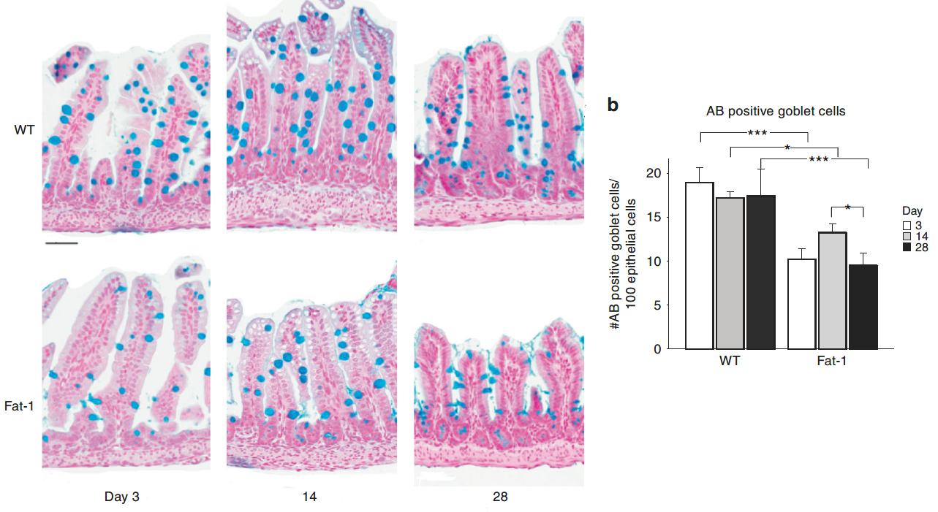
n-3 Dominant Fatty Acid Profiles Decrease Number of Goblet Cells
AB, Alcian Blue; Fat-1, fat-1 transgenic mice; WT, wild-type mice,
Singh P, et al. Pediatr Res. 2019;85:556-565. Used with permission from Springer Nature.

Slide 35
n-3 Dominant Fatty Acid Profiles Increase Cell Differentiation Markers, Decrease Genes Regulating Tight Junction
Singh P, et al. Pediatr Res. 2019;85:556-565. Used with permission from Springer Nature.

Slide 36
Nutrient Specific Impact on Gut Development
As a package of care (breast milk vs other), or as specific elements, direct impact on the intestinal environment (microbiome/inflammation) and development that determine the balance between health and disease
Not just local, for the gut, also systemic ramifications
We should not presume safety, or likely no harm, with these bioactive molecules
Need to understand dose, balance, windows of opportunity, and best delivery strategies

Slide 37
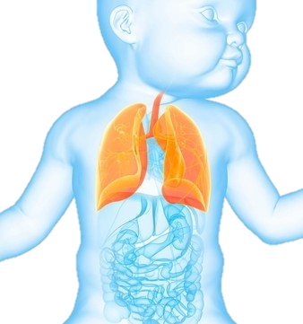
Nutrition AND Lung Development
Image Credit: Sebastian Kaulitzki/Science Source

Slide 38
Epidemiologic Data Demonstrate that Growth Attainment in NICU is Associated with BPD Risk
BPD, bronchopulmonary dysplasia.
Ehrenkranz RA, et al. Pediatrics. 2006 ;117:1253-61.

Slide 39
Nutrition and BPD: Mechanisms?
BPD
Nutrition
Is nutrition driving the lung disease (A), or is the lung disease driving the nutritional intake (B)
Role of nutrition:
Primary—Direct evidence that a specific nutritional parameter or nutrient is in the pathway of lung injury or repair
Secondary—A proxy to our practices around lung disease (fluid restriction, diuretics, steroids)
Secondary
? Increased energy expenditure
BPD, bronchopulmonary dysplasia.

Slide 40
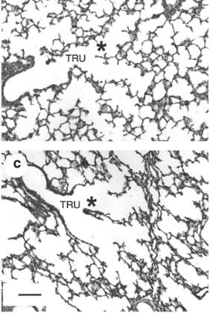
Restricted Nutrition/Postnatal Growth Restriction
Preclinical Animal Data
Alveolar formation is dysregulated by restricted nutrition
Lamb
NIS vs NIS + RN; RN = lower fluids, fat, protein, calories (150 kcal/k/d v 60 kcal/k/d)
21 day model
RN = reduced alveolar count, increased septal wall thickness, decreased caspase-3 (apoptosis), decreased PCNA (proliferation)
Unable to determine specific nutrient effects; or windows of opportunity/vulnerability
NIS, noninvasive support; PCNA, proliferating cell nuclear antigen; RN, restricted nutrition.
Joss-Moore LA, et al. Pediatr Res. 2016;80:719-728. Used with permission from Springer Nature.

Slide 41
Base Diet—Breast Milk
Beyond Necrotizing Enterocolitis Prevention: Improving Outcomes With an Exclusive Human Milk–Based Diet¹
Multicenter, retrospective cohort
Pre-, Post-exclusive HUM diet
n= 1,587
BPD defined as need for oxygen at 36 weeks PMA
BOV 56.3% vs HUM 47.7% (p=0.0015)
Does Breastmilk Influence the Development of BPD?²
Multicenter, prospective cohort
Exclusive formula vs exclusive breast milk
n= 462
BPD defined as need for oxygen at 36 weeks PMA + moderate/severe categories as defined by the NIH
Formula 20.9% vs BM 11.2% (p=0.005)
BM, breast milk; BOV, bovine-based diet; BPD, bronchopulmonary dysplasia; HUM, human milk-based diet; PMA, postmenstrual age.
1. Hair AB, et al. Breastfeed Med. 2016;11:70-4. 2. Spiegler J, et al. J Pediatr. 2016;169:76-80.e4.

Slide 42
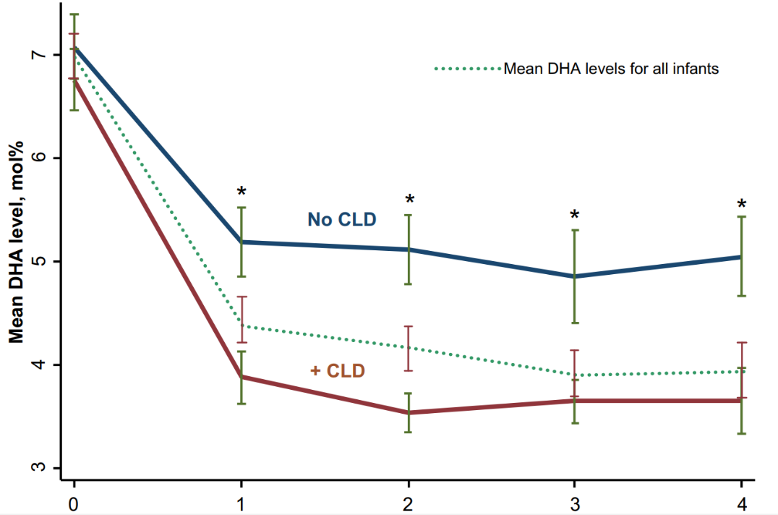
Low Blood Levels of DHA Associated With Increased Risk of BPD
BPD, bronchopulmonary dysplasia; CLD, chronic lung disease; DHA, docosahexaenoic acid.
Martin CR, et al. J Pediatr. 2011;159:743-749.e1-2.

Slide 43
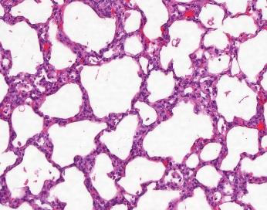
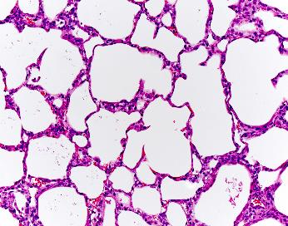
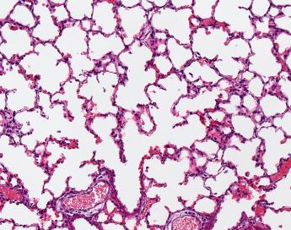
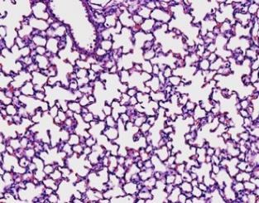
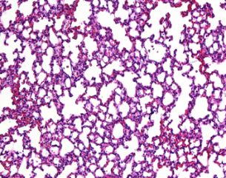
DHA and AA Terminal Mediators Reduce Hyperoxia-Induced Changes in Lung Development
LXA4
(-) Inflammation
(-) TIMP1
RvD1
Resolvin D1 (DHA product) reduces lung inflammation
Lipoxin A4 (AA product) reduces lung inflammation and improves lung (alveoli) development
Together, protect against lung injury in face of high oxygen exposure
Decreased SWT
(+) TGFb2
LXA4
Room Air
RvD1 & LXA4
Increased Alveolarization
Martin CR, et al. PLOS One. 2014;9:e98773.

Slide 44
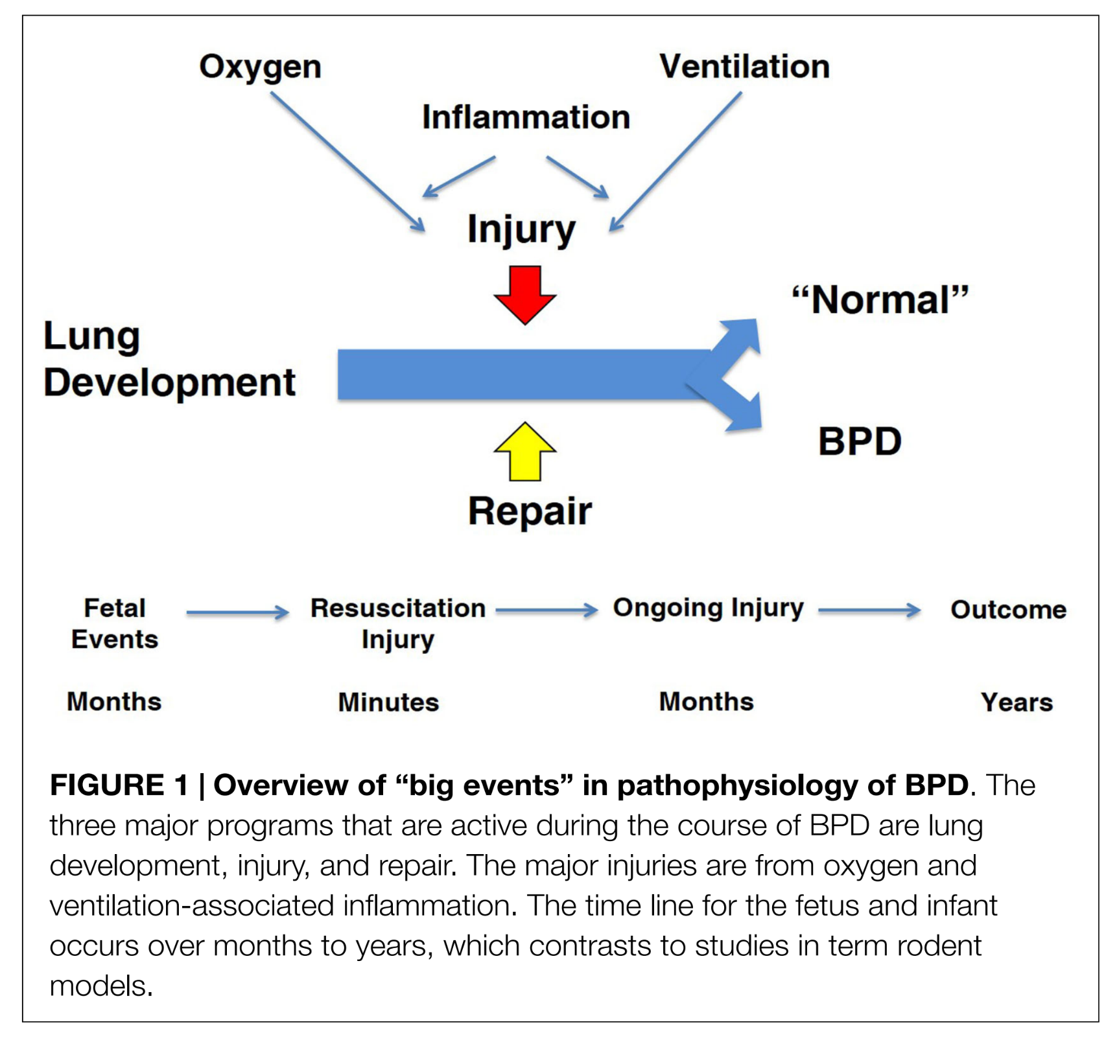
Nutrition Interfaces Throughout Lung Development, Injury, and Repair
T1 preclinical/animal evidence strongly links nutrition with lung development and disease pathogenesis
Epidemiology studies and small clinical trials support nutrition modulating disease
T3 translation challenging mostly due to:
Lack of well-designed studies
Need to ensure adequate numbers of infants at highest risk
Not understanding the what, why, how, and when dynamic; no biomarkers of nutritional efficacy
Animal models incomplete representative of the preterm biology and competing exposures— antenatal to postnatal; and models may need to be iteratively reassessed as the disease changes
Jobe AH, et al. Front Med. 2015;2:49. Used under terms of a Creative Commons License.

Slide 45
Physiology and Development Driven by Lipid-Derived Nutrients
Lipids constitute an example of what needs to be considered when investigating nutrient driven research
Must be thoroughly studied with the goal of rigor and reproducibility; just because it is a constituent of nutrition, breast milk or formula, cannot presume safety
Giving in isolation or at a wrong dose, DHA—in and of itself or due to the ancillary effects to other fatty acids—may drive unwanted biological effects
DHA, docosahexaenoic acid.

Slide 46
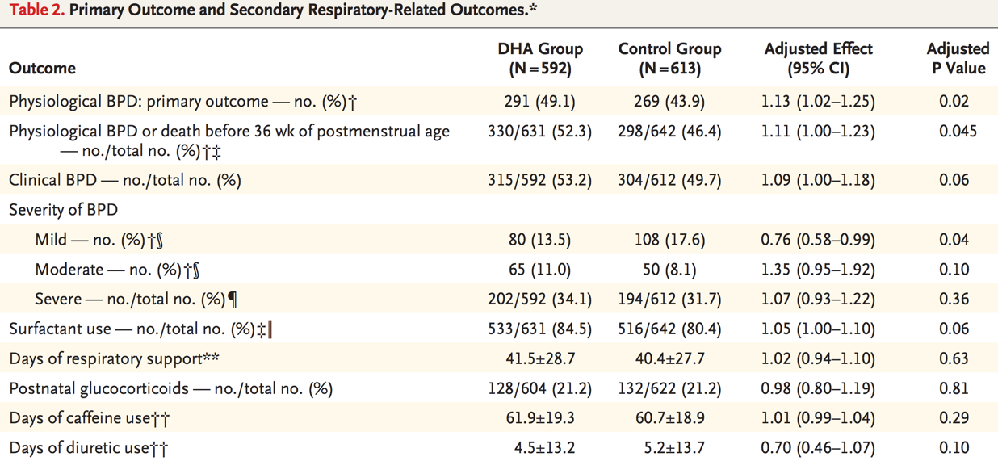
Docosahexaenoic Acid and Bronchopulmonary Dysplasia in Preterm Infants
DHA, docosahexaenoic acid.
Collins CT, et al. N Engl J Med. 2017;376(13):1245-1255. Used with permission from Massachusetts Medical Society.

Slide 47
A Word of Caution
DHA, docosahexaenoic acid.
Collins CT, et al. N Engl J Med. 2017;376:1245-1255.

Slide 48
Essentiality of Arachidonic Acid
Growth and neurodevelopment^{1–3}
Primary fatty acid in preterm brains until early term⁴
Reduction associated with 40% increase in nosocomial sepsis⁵
Provision of its distal metabolite (Lipoxin A4) improves alveologenesis in murine hyperoxia induced lung injury;⁶ reduced AA decreases alveologenesis⁷
Reduction associated with increased risk of retinopathy of prematurity⁸
AA, arachidonic acid.
1. Carlson SE, et al. Proc Natl Acad Sci U S A 1993;90:1073-7. 2. Alshweki A, et al. Nutr J. 2015;14:101. 3. Hadley KB, et al. Nutrients. 2016;8:216. 4. Martinez M. Brain Res.1992;583:171-82. 5. Martin CR, et al. J Pediatr. 2011;159:743-749.e1-2. 6. Martin CR. AAP Neoreviews. 2015;16. 7. Lavoie JC, et al. JPEN J Parenter Enteral Nutr 2018. 8. Löfqvist CA, et al. JAMA Ophthalmol. 2018;136:271-277.

Slide 49
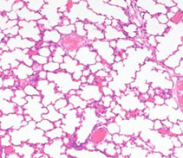
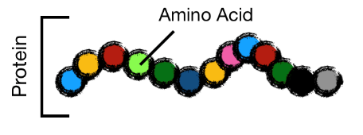
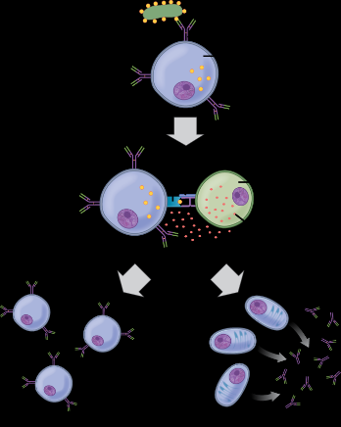
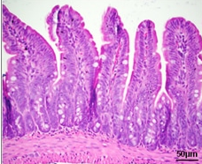
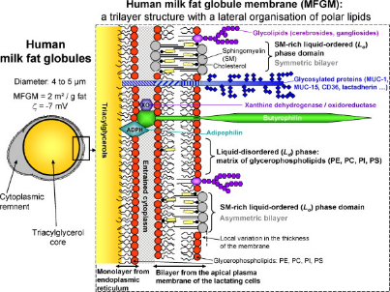
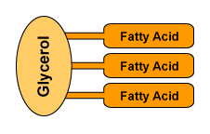
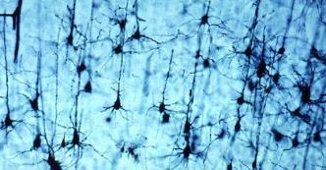
Understanding Nutrition at the Molecular Level
Total calories (energy)
Protein
Fat
Breast Milk
What? When? How?

Slide 50
Developmental Origins and the Brain

Slide 51
Early Neural Development Is Important—Immediately and Later
Early years (fetal to 3 years): Development and sensitivity of early neural systems to extrinsic influences
Primary systems
Learning and memory (hippocampus/striatum)
Speed of processing (myelination)
Reward (dopamine/serotonin)
Later developing higher order neural systems: Rely on early developing neural systems
Prefrontal Cortex
Initial connectivity from HC, striatum (early in life)
Examples: Prematurity, IUGR, newborn ID
Maintenance (throughout development)
Example: Preschool development programs
HC, hippocampus; ID, iron deficient; IUGR, intrauterine growth restriction.
Wachs TD, et al. Ann N Y Acad Sci. 2014;1308:89-106.

Slide 52
Developing Human Brain
Cowan MW. The development of the brain. Sci Am. 1979;241:113-133. Illustration by Tom Prentiss. Reproduced with permission from Springer Nature America, Inc. © 1979 Scientific American, a division of Springer Nature America, Inc.

Slide 53
Human Brain Development
Thompson RA, Nelson CA. Am Psychol. 2001;56:5–15. Reproduced with permission of the American Psychological Association.

Slide 54
Role of Nutrition in Brain Development
Brain is developing in the late fetal and early neonatal period
Regionalized process
At risk: Hippocampus, myelination, neurotransmitters
Highly metabolic process
60% of total body O₂ consumption†
Reliant on metabolic substrates (nutrients) that support metabolism (eg, O₂, glucose, amino acids, iron, copper, iodine)
†Kuzawa CW. Am J Phys Anthropol. 1998;Suppl 27:177-209.

Slide 55
Nutrients and Brain: Importance of Timing
Brain is not a homogenous organ
Regions (cortex, hippocampus, striatum, cerebellum)
Processes (myelin, neurotransmitters)
All have different developmental trajectories
Vulnerability to nutrient deficit is based on
When nutrient deficit occurs
Region’s requirement for that nutrient at that time

Slide 56
Nutrients That Affect Early Brain Development and Later Adult Function
Macronutrients
Vitamins/Cofactors
Protein^{1,2}
Fats (LC-PUFA)^{1,2,3}
Glucose^{1,2}
B vitamins (B6, B12¹)
Vitamin A
Vitamin K
Folate^{1,2,3}
Choline^{1,2,3}
Micronutrients
Iron^{1,2,3}
Zinc^{1,2}
Copper^{1,2}
Iodine (Thyroid)^{1,2}
¹Exhibits critical/sensitive period for neurodevelopment
²Early deficiency results in long-term dysfunction
³Evidence for epigenetic mechanism
Cusick SE, et al. J Pediatr. 2016;175:16–21.

Slide 57
Examples of Nutrients and Regional vs Global Perinatal Brain Effects
Nutrient | Brain Requirement for Nutrient | Affected Areas
Protein-energy | Cell proliferation, Cell differentiation, Synaptogenesis, Growth factors | Global Cortex Hippocampus
Iron | Myelin Dopamine Energy | White matter Striatal-frontal Hippocampal-frontal
Zinc | DNA Neurotransmitter release | Autonomic NS Hippocampus Cerebellum
LC-PUFAs | Synaptogenesis Myelin | Eye Cortex
ANS, autonomic nervous system; LC-PUFAs, long-chain polyunsaturated fatty acids.
Georgieff MK. Am J Clin Nutr. 2007;85:614S-620S.

Slide 58
Evidence for Long-Lasting Effects of Early Nutritional Status on Brain in Humans
Outcomes of IUGRs¹
Lower IQ
Poorer verbal ability
Worse visual recognition memory
15% with mild neurodevelopmental abnormalities
30% increased risk of schizophrenia²
Guatemalan studies show effects 25 years after protein supplementation in childhood³
Fetal iron deficiency increases risk of
Schizophrenia⁴
Autism⁵
Depression/anxiety⁶
Poorer executive function⁷
ID, iron deficient; IUGR, intrauterine growth restriction.
1. Strauss RS, et al. J Pediatr. 1998;133(:67-72. 2. Eide MG, et al. Psychol Med. 2013;43:2057-66. 3. Pollitt E, et al. J Nutr. 1995;125:1111S-1118S. 4. Insel BJ, et al. Arch Gen Psychiatry. 2008;65:1136-44. 5. Schmidt RJ, et al. Am J Epidemiol. 2014;180:890-900. 6. Lozoff B, et al. Pediatrics. 2000;105:E51. 7. Lukowski AF, et al. Nutr Neurosci. 2010;13:54-70.

Slide 59
Effect of Postnatal Failure to Gain Weight after IUGR on 7-year IQ
IQ at 7 years
IUGR, intrauterine growth restriction.
Pylipow M, et al. J Pediatr. 2009;154:201-6.

Slide 60
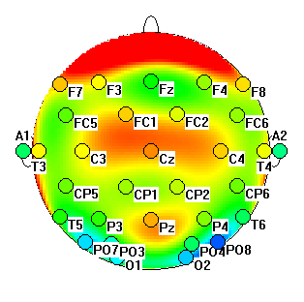
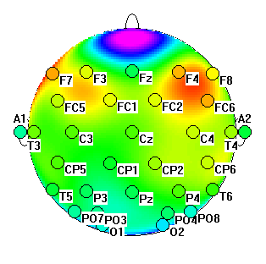
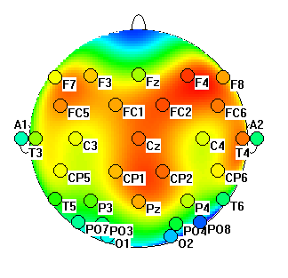
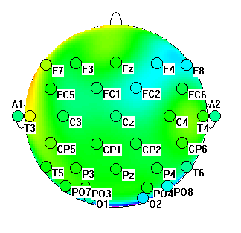
Long-Term Effects of Newborn ID at 3.5 Years
Control
Risk
Familiar
Stimulus
Infants who were iron deficient as newborns have a differently wired brain and process memory events differently even after iron repletion
Novel
Stimulus
ID, iron deficient.
Fetal ID disrupts neonatal learning and memory
Heat maps courtesy Michael K. Georgieff, MD, Center for Neurobehavioral Development. Photo Credit: Jon Wilson/Science Source

Slide 61
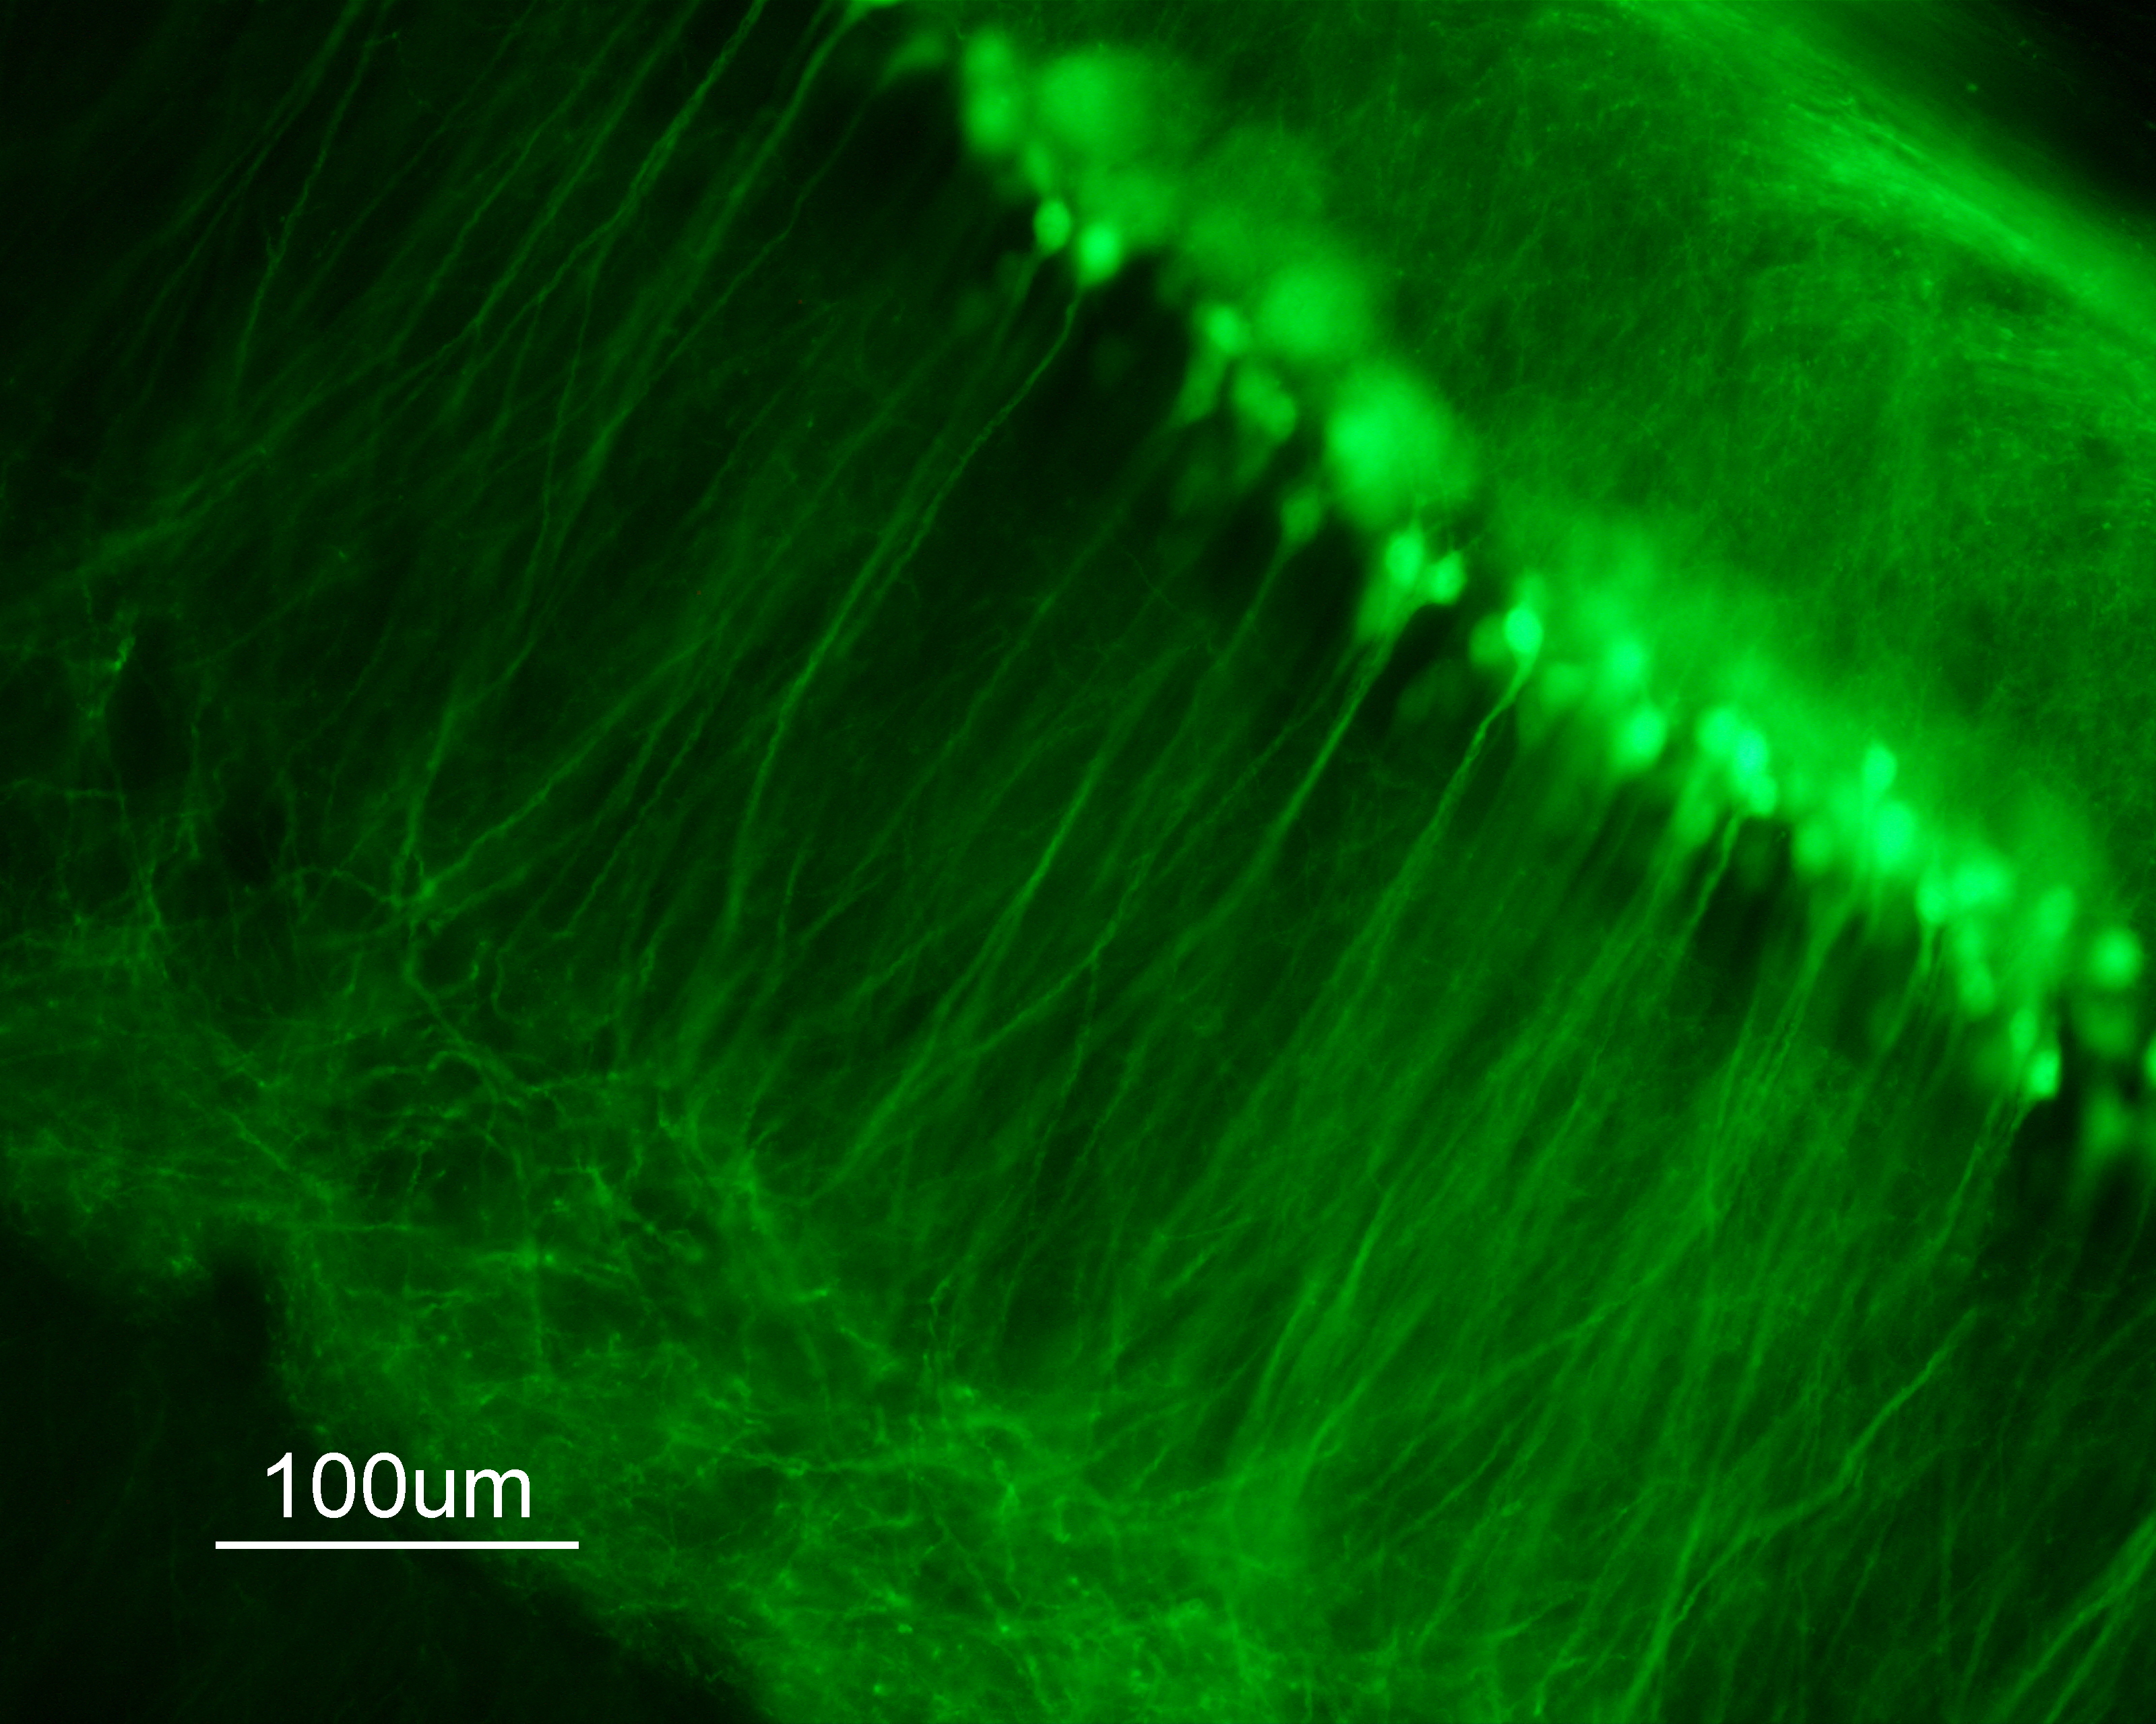
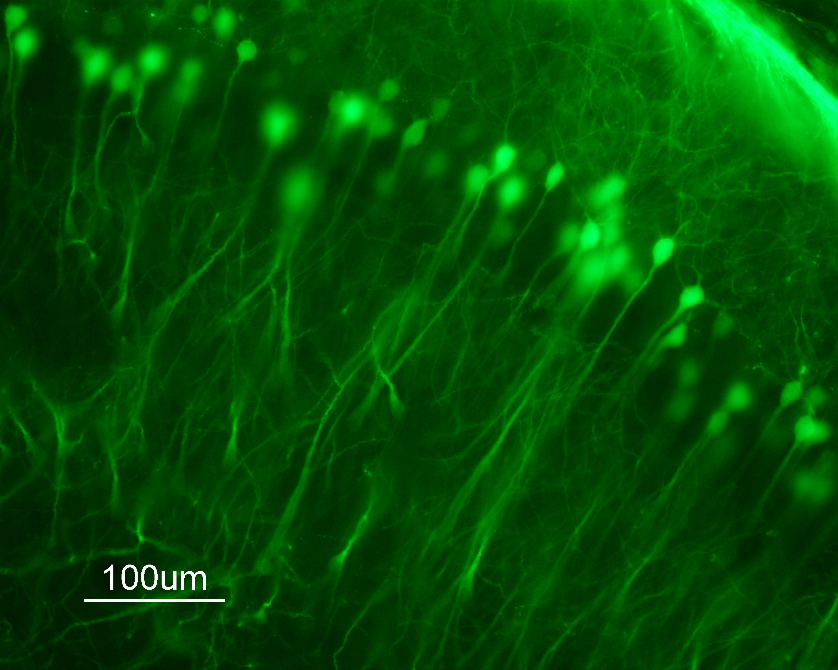
Two Major Theories for Long-term Loss of Synaptic Plasticity
1
Residual Structural Deficits
Nutrient deficiencies during critical periods of development result in permanent structural change¹⁻⁴
Disordered neuronal structures relate to neurobehavioral defects^{5,6}
IS
ID
IS, iron sufficient; ID, iron deficient.
1. Hensch TK. Annu Rev Neurosci. 2004;27:549-79. 2. Carlson ES, et al. J Nutr. 2009;139:672-9. 3. Fretham SJ, et al. Hippocampus. 2012;22:1691-702. 4. Callahan LS, et al. Dev Neurosci. 2013;35:427-36. 5. Jorgenson LA, et al. Hippocampus. 2005;15:1094-102. 6. Pisansky MT, et al. Hippocampus. 2013;23:952-62.

Slide 62
Critical Periods
As the brain ages, it loses plasticity and ability to recover
Developing brain is highly vulnerable but also has greater plasticity
Cellular basis of critical periods being elucidated in
Visual system, cortex, hippocampus, language nuclei (bird)
Lower efficiency
Higher plasticity
More amenable to treatment
Higher efficiency
Lower plasticity
Less amenable to treatment
Critical period of rapid development

Slide 63
Two Major Theories for Long-Term Loss of Synaptic Plasticity (continued)
2
Altered Regulation of Synaptic Plasticity Genes Through Epigenetic Modification
Gene networks responsible for neurobehavioral performance and risk of psychopathology
Specific genes: eg, BDNF
Critical for
Neuronal differentiation during development
Maintenance of adult plasticity
Epigenetically modifiable by
Fetal and neonatal stress
Early life nutrition
BDNF, brain-derived neurotrophic factor.
Martinowich K, et al. Science. 2003;302:890-3. Tyagi E, et al. Neurobiol Dis. 2015;73:307-18.

Slide 64
Epigenetic Modifications of Chromatin
Methylation of CpG Islands
Methyl (CH₃) groups attach to “islands” of DNA where C (Cytosine) and G (Guanine) nucleotides are next to each other
More methylation; less DNA transcription  less protein
Histone Acetylation and Methylation
Histones found outside of DNA nucleotides and wind around them
Histone status can “open up” gene to more transcription or “close it off” leading to less transcription
Overall effects depend on whether genes are active or repressive
Difficult to make predictions on effect without mapping pathways

Slide 65
Nutrients, Epigenetics, and the Developing Brain Several fetal/neonatal nutritional conditions associated with brain epigenetic modifications in rodents
IUGR
Generalized fetal malnutrition: Responsible nutrients have not been isolated
Activation of glucocorticoids: Stress alters BDNF DNA methylation
LC-PUFA
DNA methylation of BDNF
Methyl donors and DNA methylation
Choline
Folate
Iron
Vitamin A
Riboflavin
Iron deficiency, anemia (hypoxia), or both
Vitamin A supplementation reduces DNA methylation
Cofactor for small family of lysine histone demethylases
No current evidence for zinc, copper, iodine, selenium, B12, thiamine, other B vitamins, vitamin E, vitamin D
BDNF, brain derived neurotrophic factor; IUGR, intrauterine growth restriction ; LC-PUFA, long-chain polyunsaturated fatty acids.
Ke X, et al. Int J Dev Neurosci. 2014;38:59-67. Grissom NM, et al. Int J Dev Neurosci. 2013;31:406–14. Ke X, et al. Physiol Genomics. 2010;42:177-89. Zeisel S. Nutrients. 2017;9.pii: E445; Ly A, et al. J Nutr Biochem. 2016;33:103–10; Cho CE, et al. Epigenetics. 2013;8:710-9; Barua S, et al. Epigenetics Chromatin. 2014;7:3; Langie SA, et al. FASEB J. 2013;27:3323-34. Blegen MB, et al. Physiol Rep. 2013;1:e00096; Tran PV, et al. Am J Physiol Regul Integr Comp Physiol. 2015;308:R276-82.

Slide 66
Prenatal Choline Supplementation
Many populations do not get adequate iron in their diet
Grain based
Iron inhibitors (eg, phytates, tea)
Choline
Common B-complex vitamin found in eggs, cruciferous vegetables
Improved electrophysiology, biochemistry, brain morphology, learning, and memory when given during gestation
Potential biological mechanisms
Acetylcholine (neurotransmitter)
Phosphotidylcholine (myelin component)
Epigenetic modification (CH₃ donor)†
†Zeisel S. Nutrients. 2017;9.pii: E445.

Slide 67
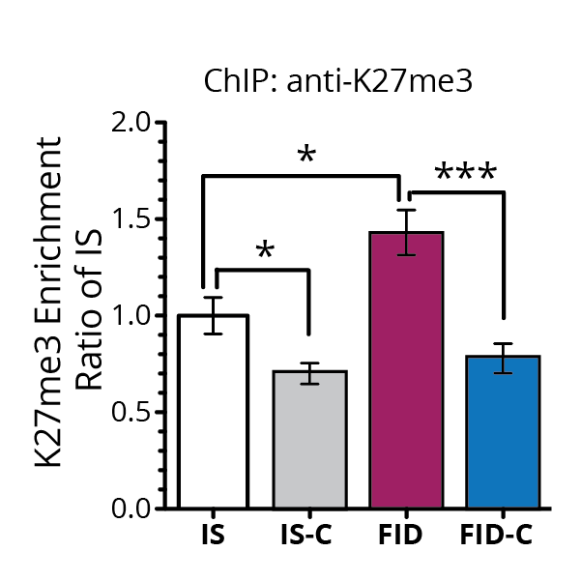
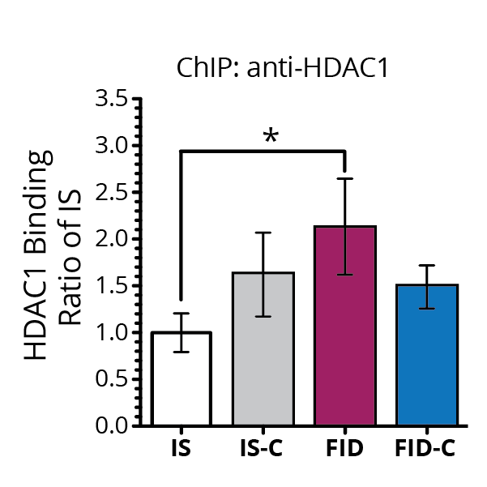
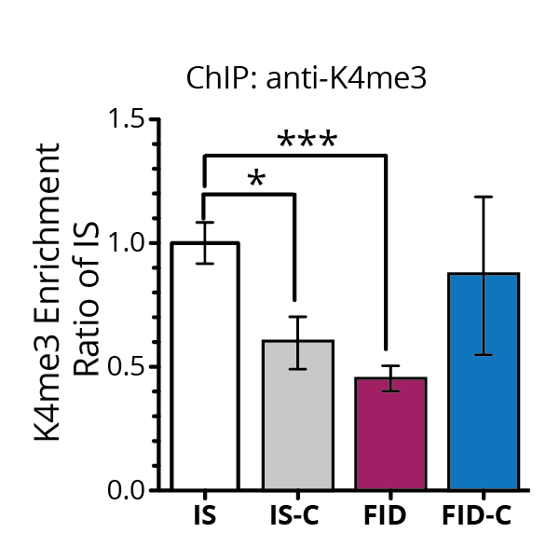
Prenatal Choline Rx Reverses Long-term Epigenetic Modifications Caused by Early Life ID
A
B
C
D
BDNF, brain-derived neurotrophic factor; ChIP, chromatin immunoprecipitation assay; FID, formerly iron deficient; HDAC, histone deacetylases; IS, iron sufficient.
Tran PV, et al. Am J Physiol Regul Integr Comp Physiol. 2015;308:R276-R282.

Slide 68
Refinement of the Barker Hypothesis
Barker’s associations stronger if difference between degree of IUGR and rapidity of postnatal growth is considered¹
High weight gain in first year after IUGR
Isn’t that “catch-up growth”?
Concept of a “thrifty phenotype” in utero = “fetal anticipation”²
Designed to preserve vital systems during periods of relative nutrient insufficiency (IUGR)
Caloric demand of human fetal brain, up to 60%³
Programming of peripheral muscle insulin resistance to divert glucose to brain
Not designed to handle sudden large amounts of nutrient delivery (rapid postnatal re-feeding)
IUGR , intrauterine growth restriction.
1. Singhal A, et al. Lancet. 2004;363:1642-5. 2. Gluckman PD, et al. Science. 2004;305:1733-6. 3. Kuzawa CW. Am J Phys Anthropol. 1998;Suppl 27:177-209.

Slide 69
Fetal Programming in IUGR: Is Catch-up Growth a Good Idea?
Term, SGA infants given a “growth promoting formula” had higher diastolic BP at 6–8 years of age compared to those on standard formula†
Rat model of maternal protein restriction during pregnancy:
Feeding extra protein for catch-up growth resulted in early adult death, especially in males
SGA, small for gestational age.
†Singhal A, et al. Lancet. 2004;363:1642-5.

Slide 70
Does the Postnatal Growth Pattern After IUGR Affect Later IQ?
Slow postnatal growth after IUGR decreases IQ even further^{1,2}
Does excessive growth also affect IQ?
464 IUGR infants (<2.2 kg at >37 weeks)²
IQ as a function of postnatal weight gain in the first 4 postnatal months
IUGR, intrauterine growth restriction.
1. Casey PH, et al. Pediatrics. 2006;118:1078-86. 2. Pylipow M, et al. J Pediatr. 2009;154:201-6.

Slide 71
Effect of Postnatal Excess Weight Gain After IUGR on 7-year IQ
IQ at 7 years
IQ lost due to excess weight gain
(4-5 points)
IUGR, intrauterine growth restriction.
Pylipow M, et al. J Pediatr. 2009;154:201-6.

Slide 72
Effect of Maternal Obesity on Offspring Mental Health
Excessive GWG
Maternal Obesity, High-Fat Diet, Metabolic Disease
Intrauterine Development
Early Post-natal Development
Inflammation
Sex Hormones
Metabolic Hormones
Excess Nutrients
Impaired Brain Development
5-HT
Melanocortin
DA
↑Risk of Mental Health and Neurodevelopmental Disorders
Reproduced from Rivera HM, Christiansen KJ, Sullivan EL. Front Neurosci. 2015;9:194.

Slide 73
Clinical Implications
Preconception
Weight management in women of child-bearing age | Reduction of obesity
Nutrient sufficiency | Not just macronutrients, but micronutrients 25%–40% of women of CBA are iron deficient Not just a low- and middle-income country problem
CBA, child-bearing age.

Slide 74
Clinical Implications (continued)
Gestation
Blood pressure control | 10% of population suffered IUGR 75% of IUGR in US is due to maternal hypertension or preeclampsia during pregnancy 50% are iron deficient at birth All have protein malnutrition
Blood sugar control | 10% of pregnancies complicated by maternal diabetes (pregestational or gestational) 65% of infants of diabetic mothers are iron deficient at birth
Stress reduction | Maternal stress  fetal stress  abnormal fetal brain development (and iron deficiency)
Weight management | Reduction of obesity
Nutrient sufficiency | Prenatal vitamins, including iron LC-PUFA (DHA) supplementation
IUGR, intrauterine growth restriction; LC-PUFA, long-chain polyunsaturated fatty acids; DHA, docosahexaenoic acid.

Slide 75
Clinical Implications (continued)
Postnatal (especially 0–3 years)
Nutrition | BREAST MILK LC-PUFA (DHA) supplementation of formula-fed babies Maintain iron and zinc sufficiency Screen for thyroid status
Avoidance/reduction of glucocorticoid steroid use | Steroids alter brain development Steroids alter how critical nutrients are accreted
Reduce infectious burden | Infection and inflammation alter brain development during critical periods of growth
LC-PUFA, long-chain polyunsaturated fatty acids; DHA, docosahexaenoic acid.

