Slide 2


Faculty
David A.
Hill, MD, PhD
Assistant Professor of Pediatrics
Department of Pediatrics
Perelman School of Medicine at the University of Pennsylvania
Attending Physician
Division of Allergy and Immunology
Children’s Hospital of Philadelphia
Web: www.med.upenn.edu/hilllab
Twitter: @Lab_Hill

Slide 3
Disclosures
No personal financial conflicts of interest
Lab funding:
  CHOP
  National Institutes of Health
  American College of Asthma, Allergy, and Immunology
  American Academy of Asthma, Allergy, and Immunology
  American Partnership for Eosinophilic Disorders

Slide 4
Learning Objectives
  Comprehend the immune responses that cause the allergic march
  Discuss successes and shortfalls of current strategies to mitigate allergy in children
  Examine research and future strategies to help mitigate the allergic march in children

Slide 5
The Allergic (atopic) March
Hill & Spergel, Ann Allergy Asthma Immunol 120 (2018) 131–137

Slide 6
Longitudinal Cohort Studies Support the March Model
Longitudinal Studies of Disease Associations
 | 2° Allergy
1° Allergy |  | IgE-FA | Asthma | AR
 | AD | 1-4,24,25 | 4-13,24 | 4,11,13,24,25
 | IgE-FA | - | 3,14-19,24 | 4,14,17,19,24
 | Asthma | - | - | 12,20-24
Initially defined by population-level studies of disease incidence
Now supported by numerous longitudinal cohort studies
Lack G et al. N Engl J Med. 2003;348(11):977-85
Tsakok T et al. J Allergy Clin Immunol. 2016;137(4):1071-8
Tran MM et al. J Allergy Clin Immunol. 2018;141(2):601-607.e8
Gustafsson D et al. Allergy. 2000;55(3):240-5
Martinez FD et al. N Engl J Med. 1995;332(3):133-8
Strachan DP et al. BMJ. 1996;312(7040):1195-9
Stern DA et al. Lancet. 2008;372(9643):1058-64
Rasmussen F et al. J Allergy Clin Immunol. 2002;110(2):220-7
Illi S et al. J Allergy Clin Immunol. 2004;113(5):925-31
Matricardi PM et al. Eur Respir J. 2008;32(3):585-92
Shen CY et al. Allergy Asthma Proc. 2013;34(1):78-83
Gough H et al. Pediatr Allergy Immunol. 2015;26(5):431-7
Lowe AJ et al. Pediatr Allergy Immunol. 2017;28(4):384-90
Kulig M et al. Pediatr Allergy Immunol. 1998;9(2):61-7
Kjaer HF et al. Pediatr Allergy Immunol. 2009;20(8):726-34
Brockow I et al. J Investig Allergol Clin Immunol. 2009;19(3):180-7
Hill DA et al. BMC Pediatr. 2016;16:133
Bekkers MB et al. J Allergy Clin Immunol. 2013;132(6):1427-8
Chiu CY et al. PLoS One. 2014;9(7):e102809
Leynaert B et al. J Allergy Clin Immunol. 2004;113(1):86-93
Ponte et al. Allergy. 2008;63(5):564-9
Hamouda S et al. Clin Exp Allergy. 2008;38(5):761-6
Chawes BLK et al. J Allergy Clin Immunol. 2010;126(3):567-73.e1-8
Hill DA et al. J Allergy Clin Immunol Pract. 2018;6(5):1528-1533.
Björkander S et al. Immun Inflamm Dis. 2019;7(3):170-182
Hill DA et al. J Allergy Clin Immunol Pract. 2018;6(5):1528-1533.

Slide 7





What Causes the March?
Common genetic factors
Common environmental factors
Common type 2 inflammatory pathways

Slide 8
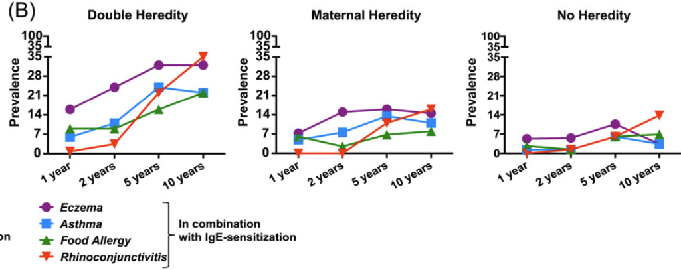
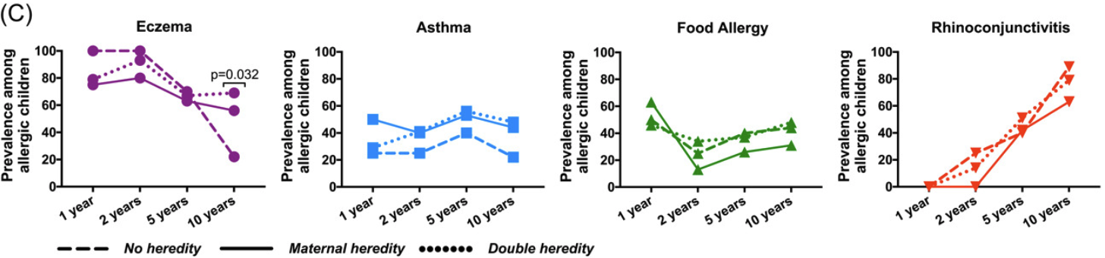
Common Genetic Factors
Allergy/Allergic Sensitization
NFATC2
PTGER4
GATA3
PLCL1
STAT6
LPP/BCL6
FOXA1
MYC
TLR1/6/10
GSDMA/B/ORMDL3
SMAD3
TSLP
IL33
IL2
HLA
LRRC32
IL1RL1/
IL18R1
IL6R
ZBTB10
RORA
PYHIN1
IKZF4
LSM3P4
IL2RB
CDK2
USP38
PFDN4
CCDC80
CARD11
ACTL9
OVOL1
FLG
GLB1
PRR5L
ZNF365
CYP24A1
NLRP10
CLEC16A
IL13
IL4
Asthma
Eczema
Graph images courtesy of Björkander S et al. Immun Inflamm Dis. 2019;7(3):170-182. CC BY 4.0.
Bønnelykke K et al. Curr Opin Immunol. 2015;36:115-126.
Björkander S et al. Immun Inflamm Dis. 2019;7(3):170-182.

Slide 9
What Causes the March?
Common genetic factors
Common environmental factors
Common type 2 inflammatory pathways

Slide 10
Common Environmental Factors
Microbial exposure
Medication exposure
Delivery mode
Feeding practices
Pollution exposure
Infection history

Slide 11
Common Environmental Factors
Microbial exposure
Medication exposure
Delivery mode
Feeding practices
Pollution exposure
Infection history
Demographic and Clinical Characteristics of Study Populations*
Characteristic | Amish (n = 30) | Hutterite (n = 30)
Age, median (range) | 11 (8-14) | 12 (7-14)
Girls, no. | 10 | 10
Sibships, no. | 15 | 14
Children with asthma, no. | 0 | 6
Positivity for allergen-specific IgE
>0.7 kUA/L | 5 | 9
>3.5 kUA/L | 2 | 9
Serum IgE, median (IQR) | 21 (10-57) | 64 (15-288)
*UA denotes allergen-specific unit
Stein MM et al. N Engl J Med. 2016;375(5):411-421.
Notes:
Stein: We studied environmental exposures, genetic ancestry, and immune profiles among 60 Amish and Hutterite children, measuring levels of allergens and endotoxins and assessing the microbiome composition of indoor dust samples. Whole blood was collected to measure serum IgE levels, cytokine responses, and gene expression, and peripheral-blood leukocytes were phenotyped with flow cytometry. The effects of dust extracts obtained from Amish and Hutterite homes on immune and airway responses were assessed in a murine model of experimental allergic asthma.

Slide 12
Common Environmental Factors
20,000
Microbial exposure
Medication exposure
Delivery mode
Feeding practices
Pollution exposure
Infection history
15,000
EU/m²
10,000
5000
0
Amish homes
Hutterite homes
Stein MM et al. N Engl J Med. 2016;375(5):411-421.
Notes:
Stein: We studied environmental exposures, genetic ancestry, and immune profiles among 60 Amish and Hutterite children, measuring levels of allergens and endotoxins and assessing the microbiome composition of indoor dust samples. Whole blood was collected to measure serum IgE levels, cytokine responses, and gene expression, and peripheral-blood leukocytes were phenotyped with flow cytometry. The effects of dust extracts obtained from Amish and Hutterite homes on immune and airway responses were assessed in a murine model of experimental allergic asthma.

Slide 13
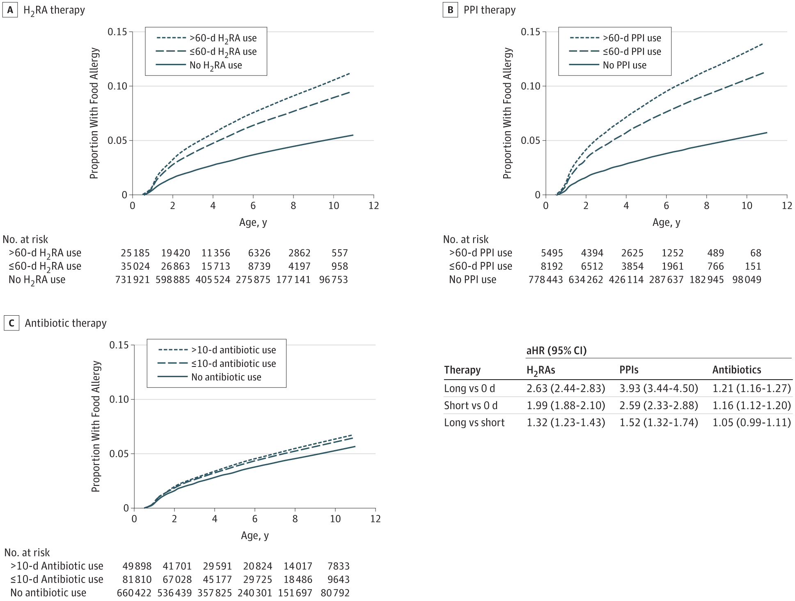
Common Environmental Factors
H₂RA Use
PPI Use
Microbial exposure
Medication exposure
Delivery mode
Feeding practices
Pollution exposure
Infection history
Antibiotic Use
Mitre E et al. JAMA Pediatr. 2018;172(6):e180315. This work has been identified as being free of known restrictions under copyright law, including all related and neighboring rights. Public Domain Mark 1.0
Notes:
Mitre: A retrospective cohort study was conducted in 792 130 children who were Department of Defense TRICARE beneficiaries with a birth medical record in the Military Health System database between October 1, 2001, and September 30, 2013, with continued enrollment from within 35 days of birth until at least age 1 year. Children who had an initial birth stay of greater than 7 days or were diagnosed with any of the outcome allergic conditions within the first 6 months of life were excluded from the study. Data analysis was performed from April 15, 2015, to January 4, 2018.

Slide 14
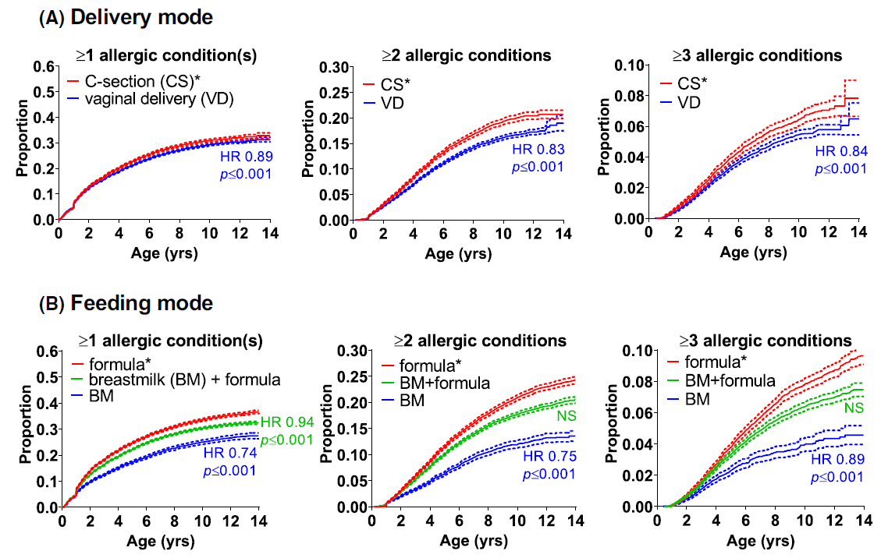
Common Environmental Factors
Delivery Mode
Microbial exposure
Medication exposure
Delivery mode
Feeding practices
Pollution exposure
Infection history
Feeding Mode
Gabryszewski SJ et al. Pediatr Allergy Immunol. 2021;10.1111/pai.13486.
With permission from John Wiley and Sons
Notes:
Mitre: A retrospective cohort study was conducted in 792 130 children who were Department of Defense TRICARE beneficiaries with a birth medical record in the Military Health System database between October 1, 2001, and September 30, 2013, with continued enrollment from within 35 days of birth until at least age 1 year. Children who had an initial birth stay of greater than 7 days or were diagnosed with any of the outcome allergic conditions within the first 6 months of life were excluded from the study. Data analysis was performed from April 15, 2015, to January 4, 2018.

Slide 15
What Causes the March?
Common genetic factors
Common environmental factors
Common type 2 inflammatory pathways

Slide 16
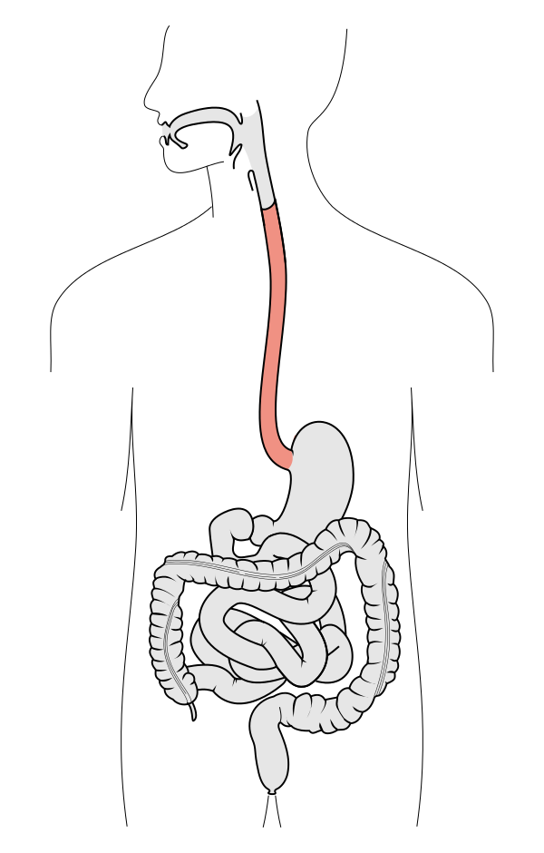
Common Type 2 Inflammatory Pathways
Gabryszewski SJ, Hill DA. Ann Allergy Asthma Immunol. 2021;10.1016/j.anai.2021.04.036.

Slide 17
Atopic Dermatitis Is the March “Gateway”
Strong link between AD and sensitization, food allergy, asthma, and allergic rhinitis
Link is particularly strong for severe AD in the first 6 months of life
This link was the basis for the LEAP study which showed early introduction of peanut in children with eczema prevented peanut allergy
P = .001
P < .001
P < .001
Martin PE et al. Clin Exp Allergy. 2015;45(1):255-264.
Du Toit G et al. N Engl J Med. 2016;374(15):1435-1443.

Slide 18



Can We Prevent the March?
Interfere with the “gateway” (atopic dermatitis therapy)
Interfere with sensitization (biologics)
Immunotherapy

Slide 19
Does Treatment of AD Protect Against Allergy?
There is considerable interest in determining whether effective AD therapy may interfere with sensitization
Lowe AJ et al. Br J Dermatol. 2018;178(1):e19-e21.
Perkin MR et al. J Allergy Clin Immunol. 2021;147(3):967-976.e1.

Slide 20
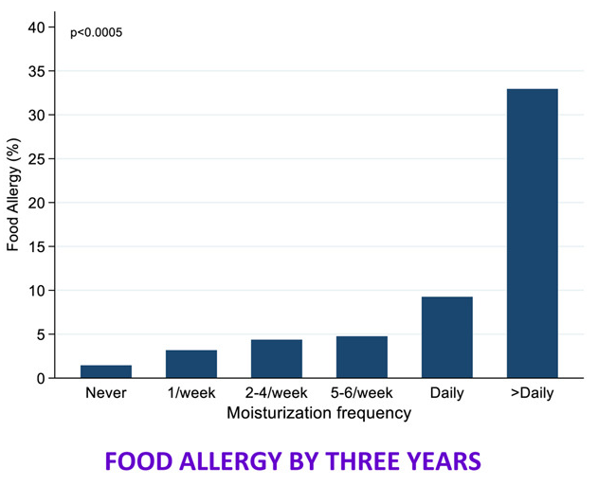
Does Treatment of AD Protect Against Allergy?
There is considerable interest in determining whether effective AD therapy may interfere with sensitization
Evidence that regular use of prophylactic emollients can decrease the expression of AD and may alter risk allergy
However, studies are ongoing (PEBBLES) and existing evidence is conflicting
P < .05
Graph courtesy of Perkin MR et al. J Allergy Clin Immunol. 2021;147(3):967-976.e1. CC BY-NC-ND 4.0.
Lowe AJ et al. Br J Dermatol. 2018;178(1):e19-e21.
Perkin MR et al. J Allergy Clin Immunol. 2021;147(3):967-976.e1.

Slide 21
Can We Prevent the March?
Interfere with the “gateway” (atopic dermatitis therapy)
Interfere with sensitization (biologics)
Immunotherapy

Slide 22
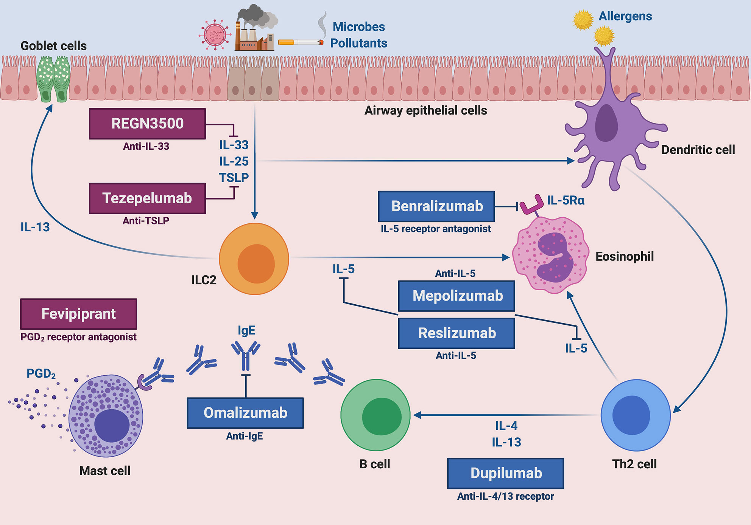
Biologic Therapies for Type 2 Inflammation
Pelaia C et al. Front Immunol. 2020;11:603312. Permission granted by open-access article distributed under the terms of the Creative Commons Attribution License (CC BY).

Slide 23
Can We Prevent the March?
Interfere with the “gateway” (atopic dermatitis therapy)
Interfere with sensitization (biologics)
Immunotherapy

Slide 24

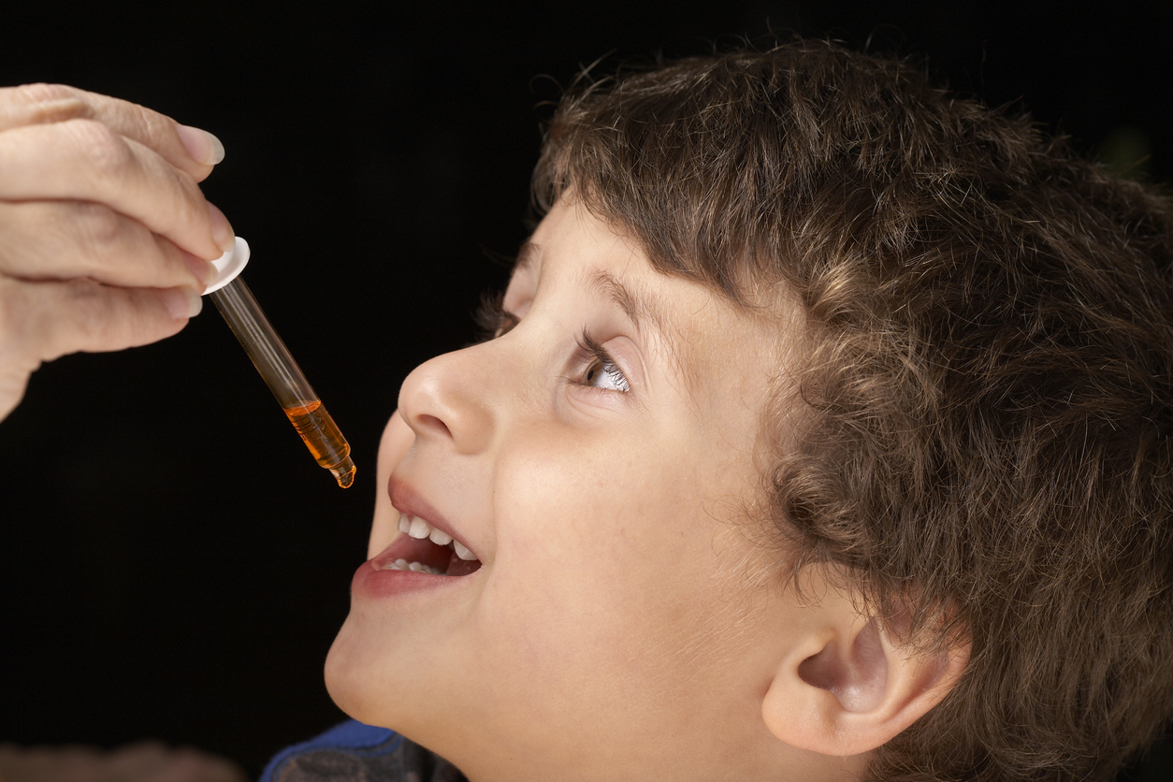
Immunotherapy
Allergic rhinitis (AR) is a risk factor for asthma
AR severity modulates asthma control
Treatment of AR improves asthma outcomes
Immunotherapy for AR improves both asthma and rhinitis symptoms and prevents future allergen sensitizations and asthma development
Sasaki M et al. Pediatr Allergy Immunol. 2014;25(8):804-809.
Crystal-Peters J et al. J Allergy Clin Immunol. 2002;109(1):57-62.
Adams RJ et la. J Allergy Clin Immunol. 2002;109(4):636-642.
Des Roches A et al. J Allergy Clin Immunol. 1997;99(4):450-453.
Marogna M et al. Allergy. 2004;59(11):1205-1210.
Pajno GB et al. Clin Exp Allergy. 2001;31(9):1392-1397.
Notes:
Sasaki et al. noted that among pediatric patients with asthma, uncontrolled asthma was present in 9.2 % of those without rhinitis, 15.3 % of those with mild-moderate rhinitis, and 29.2 % of those with severe rhinitis.

Slide 25


New Concepts in the Allergic March
Addition of eosinophilic esophagitis
March “trajectories”

Slide 26
Eosinophilic Esophagitis Is Late to the March
Longitudinal Studies of Disease Associations
 | 2° Allergy
1° Allergy |  | IgE-FA | Asthma | EoE | AR
 | AD | 2.5 | 1.5 | 3.2 | 1.9
 | IgE-FA | - | 1.5 | 9.1 | 1.7
 | Asthma | - | - | 1.9 | 1.7
 | EoE | - | - | - | 2.5
 | AR | - | - | 2.8 | -
EoE
Hill DA et al. J Allergy Clin Immunol Pract. 2018;6(5):1528-1533.

Slide 27
New Concepts in the Allergic March
Addition of eosinophilic esophagitis
March “trajectories”

Slide 28
New Concepts in the Allergic March
Addition of EoE
March “trajectories”
Gabryszewski SJ, Hill DA. Ann Allergy Asthma Immunol. 2021;10.1016/j.anai.2021.04.036.

