Slide 2
Faculty Presenter

Slide 3
Faculty Disclosures

Slide 4
Learning Objectives

Slide 5
Microbiome

Slide 6
Microbiota and Humans

Slide 7
Definitions

Slide 8
The mutualistic relationship between the gut microbiome and the host

Slide 9
Beneficial effects of the gut microbiota on the intestinal tract

Slide 10
The Gut—The Inner Tube of Life

Slide 11
Structure of an Epithelial Unit

Slide 12
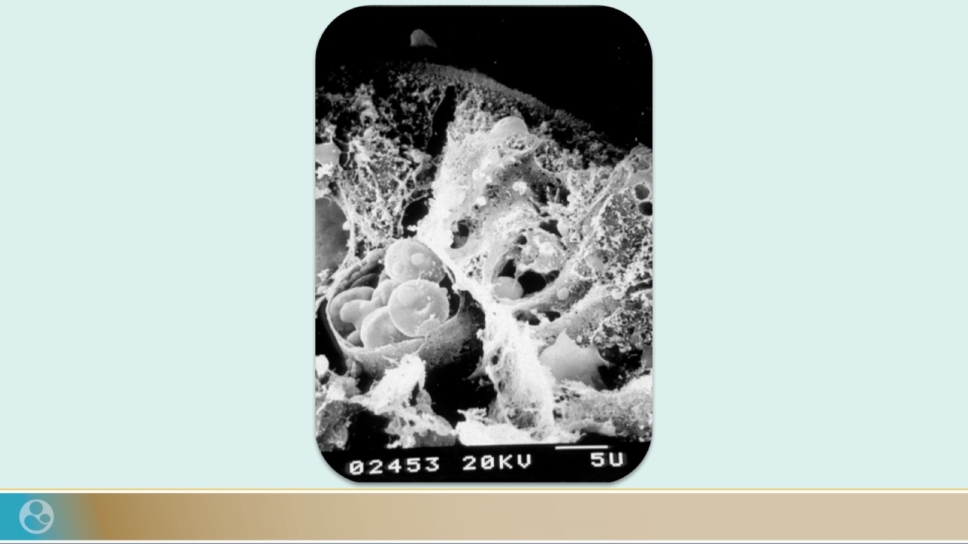

Slide 13
Host Microbial Frontline

Slide 14
The Human Microbiome

Slide 16
The Human DNA

Slide 17
The Microbiome: Who’s there?

Slide 18
Differences in Infant Microbiome Based on Delivery Mode

Slide 19
Microbial Composition Varies According to the Original Seeding

Slide 20
Development of Gut Microbiome During the Stages of Life

Slide 21
The First 1,000 Days Matter…

Slide 22
The Gut Microbiome is Like a Fingerprint

Slide 23
Is My Gut Microbiome the Same as Yours?

Slide 24
Role of the Environment in the Human Microbiota

Slide 25
Methods for Studying Gut Microbiota Composition

Slide 26
Host Gut Microbes

Slide 27
Intestinal Microbiota in Health/Disease

Slide 28
Mucus Penetrability in Human Colonic Biopsies From Ulcerative Colitis Patients

Slide 29
Role of Microbiome on Immunity

Slide 30
Promotion of Immune Regulation by the Microbiota During Steady State

Slide 31
The microbiota plays a fundamental role in the induction, education, and function of the mammalian immune system

Slide 32
Probiotics

Slide 33
Definition of Probiotics

Slide 34
Lactobacillus Rhamnosus

Slide 35
Probiotics: Properties Are Strain-Dependent ^{[1]} and Products Are Not All Formulated the Same Way ^{[2]}

Slide 36
Strain Matters: Intra-Species Variation Among Lactobacillus rhamnosus

Slide 37
Feeding the Microbiota: Prebiotics vs Probiotics ^{[1]}

Slide 38
Why the Effects of Probiotics Can Differ

Slide 39
Lactobacillus rhamnosus GG Probiotic (Trademark LGG®, ATCC 53103)

Slide 40
Characteristics of LGG®

Slide 41
LGG® Immune Activity

Slide 42
LGG® Effect on Epithelial Integrity

Slide 43
Probiotic-Derived Functional Factors

Slide 44
LGG® Probiotic Has a Unique, Strain-Dependent Mechanism of Action

Slide 46
Role of LGG® During Critical Window

Slide 47
Implication

Slide 48
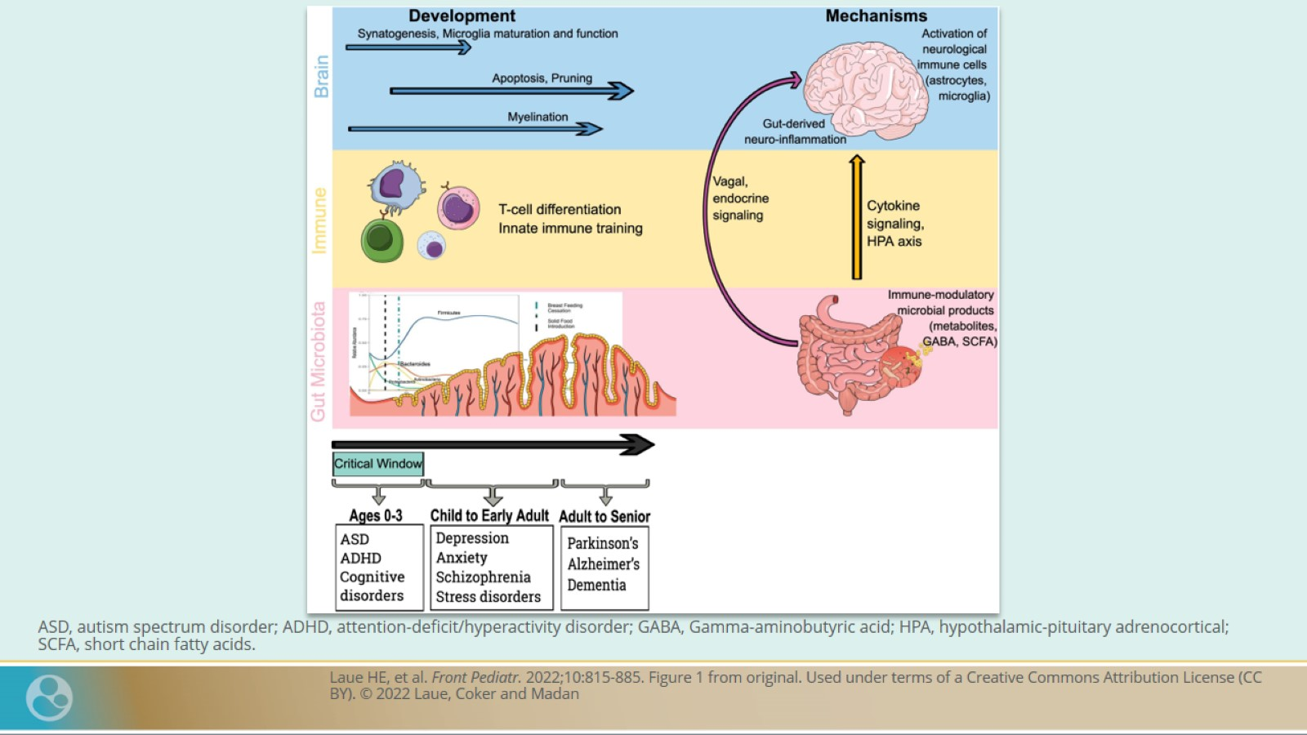

Slide 49
Understanding Allergy

Slide 50
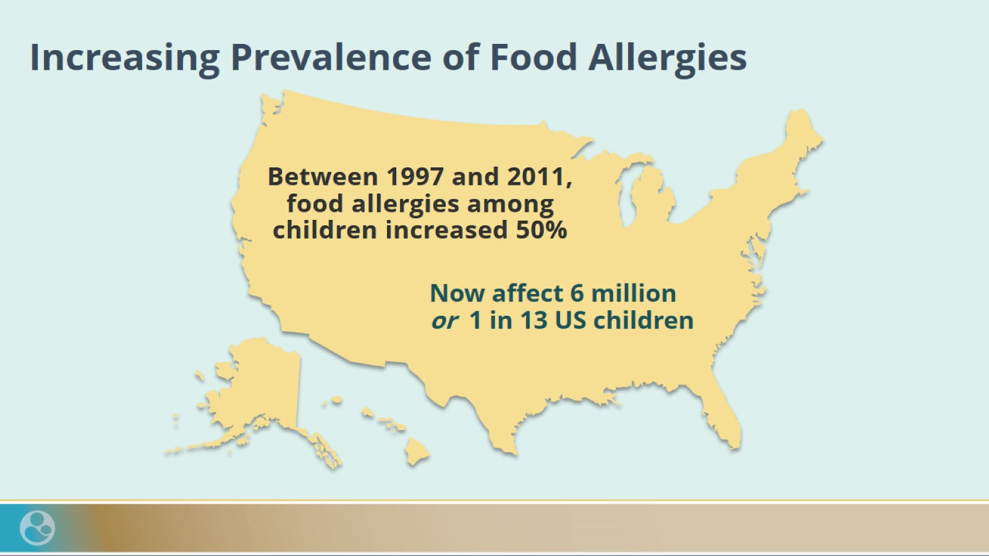
Increasing Prevalence of Food Allergies

Slide 51
Prevalence of Food Allergy Worldwide

Slide 53
Effects of Probiotics in Atopic Disease Management ^{[1]–[4]}

Slide 54
Effects of Probiotics in Atopic Disease Management ^{[1]–[4]}

Slide 55
LGG® Probiotic Has Been Shown to Play a Role in Managing Atopic Eczema

Slide 56
LGG® Probiotic Has Been Shown to Play a Role in Managing Atopic Dermatitis

Slide 57
LGG® Probiotic Has Been Shown to Play a Role in Managing Infantile Colic

Slide 58
LGG® Probiotic Reduces Inflammation and Supports Gut Barrier Function in Infants With CMAC: Fecal Calprotectin Results

Slide 59
LGG® Probiotic Reduces the Occurrence of Hematochezia in Infants With CMAC: Occult Blood Stool Results

Slide 60
Summary

