Slide 2
Disclosures:
Role | Sponsors
Research funds to Yale (principal investigator) | Ferring Pharmaceuticals Mallinckrodt Pharmaceuticals Pfizer Pharmaceuticals Prolacta Bioscience Grant from Beth Israel Deaconess Medical Center with funds originating from Mead Johnson Grant from Weill Cornell with in-kind product from Mead Johnson
Consulting | Baxter
Role | Sponsors
Research funds to Yale (principal investigator) | Allen Foundation Hauptmann Fund National Institutes of Health
Consulting | Vermont Oxford Network
Volunteer | HMBANA Executive Board Mother’s Milk Bank of the Northeast
Authorship | Nutritional Care of the Preterm Infant published by Karger with book distribution by Mead Johnson; UpToDate
Attendee | Conferences with indirect, less often direct, formula company and other industry sponsors
Controversial research | Pediatrician interaction with formula industry; detailing the cost of breastfeeding

Slide 3
Objective
Feeding=
giving nutrition
Nutrition= providing
the food necessary
for health and growth
Very Preterm Infant
Outcomes

Slide 4
Objective
Growth
Neurodevelopment
Nutrition
Preterm Infant
Bone mineralization
Anti-inflammatory
Organ system maturation
Gold standard nutrition: optimize outcomes

Slide 5
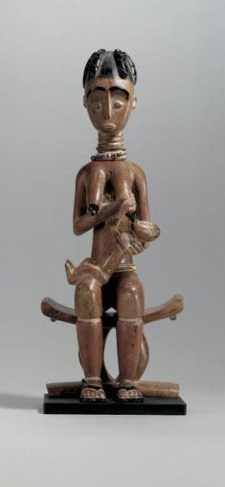

Gold Standard Nutrition for term uncomplicated newborn

Slide 6
Gold Standard Nutrition:
Breastfeeding
Breastfeeding and maternal milk are terms used throughout this talk.
I respect that some lactating parents prefer the terms chestfeeding and parent milk.

Slide 7

Very preterm infant

Slide 8
What does the preterm infant miss of fetal nutrition? Calcium and Phosphorus example
80% is accrued in the 3rd trimester
  Peak accretion is 36-38 weeks
Starting at 26 weeks
  Calcium: 90-120 mg/kg/day (2.2-3 mmol/kg/day)
  Phosphorus: 60-75 mg/kg/day (1.9-2.4 mmol/kg/day)
  Magnesium: 3-5 mg/kg/day (0.12-0.2 mmol/kg/day)
Most bone deposition
  From 24 weeks to term

Slide 9
Human Milk Nutrition for Very Preterm Infants- the Mismatch
Nutrient (enteral intake) | Very preterm infant daily need/kg | Human milk delivery (150 mL/kg/day) | Human milk delivery (200-300 mL/kg/day)
Energy, kcal | 110-130 | 98-147 | 130-294
Protein, g | 3.5-4.5 | 1-3.5 | 1.3-7
Calcium, mmol (mg) | 3-5.5 (120-220) | 1 (40) | 1.3-2 (52-80)
Phosphorus, mmol (mg) | 2.3-3.9 (70-120) | 0.7 (22) | 0.9-1.4 (29-44)
Sodium, iron, zinc, vitamins including vitamin D also mismatched need compared to intake
Daily volume mismatch between maternal milk removal and infant daily intake
Daily milk volume of at least 500-800 mL associated with sustaining milk supply
Very preterm infants often take 100-200 mL/day
If milk feed is not immediately provided from parent to infant
Loss of nutrients in storage and feed preparation
Goldberg et al 2018; Arslanoglu S et al 2019; Taylor SN 2021 in Nutritional Care of the Preterm Infant

Slide 10

Very preterm infants have limitations in early enteral nutrition delivery, so currently have a reliance on parenteral nutrition

Slide 11
Early initiation of parenteral nutrition macronutrients: decreases days to regain birthweight
Robinson D et al 2023

Slide 12
When birthweight is regained more quickly, overall hospital growth trajectory is improved and positively relates to neurodevelopment
Rochow et al 2016

Slide 13
Preterm infant macronutrient goals
Goldberg et al 2018; van Goudoever JB et al 2018

Slide 14
Preterm infant macronutrient goals
3.5
Goldberg et al 2018; van Goudoever JB et al 2018

Slide 15
Parenteral Amino Acid Goal
Maintenance dose
3-3.5 g/kg/day
Max 4 g/kg/day
Add 1g/day
3.6 g/kg/day
Robinson DL 2023

Slide 16
Parenteral Amino Acid Goal starting at 3 g/kg/day
Why?
RCT designed to study first week protein, fat, and energy including 3.5 g/kg/d amino acids
Stopped due to intervention group illness compared to control
  Sepsis (63% vs. 29%)
  Hypophosphatemia, hypokalemia, hypercalcemia
Moltu et al 2013

Slide 17
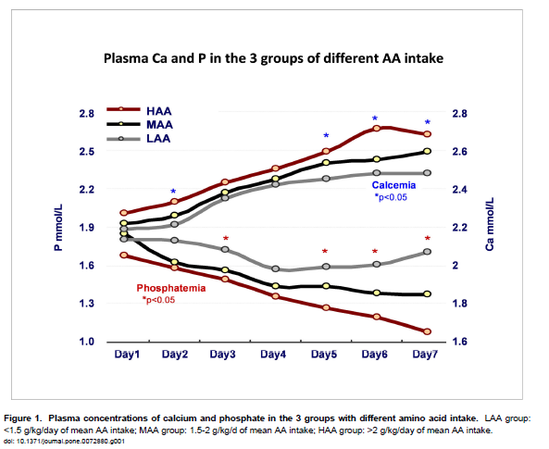
Bonsante F et al 2013

Slide 18
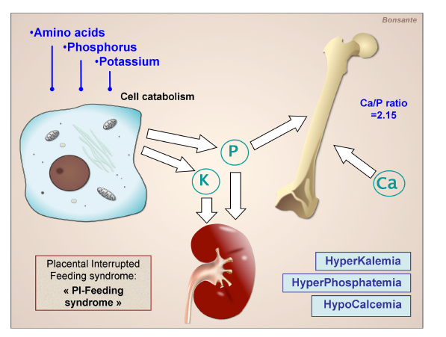
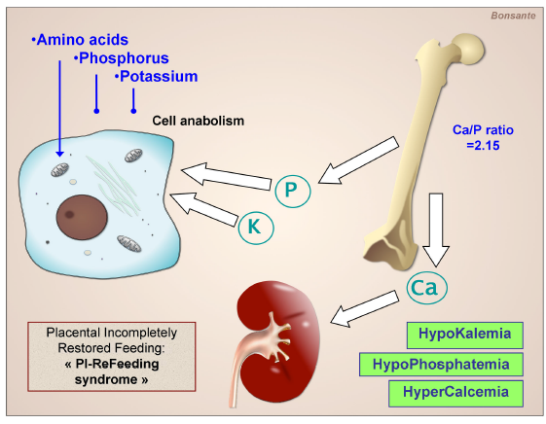
Inadequate amino acids for growth
Adequate amino acids for growth
Bonsante F et al 2013

Slide 19
Calcium/Phosphorus Homeostasis with VLBW Infant “Aggressive” Parenteral Nutrition
New syndrome:
  Placental Incompletely Restored Feeding Syndrome
Mechanism:
  Continuation of amino acid delivery from placenta to parenteral nutrition
  Inadequate phosphorus and potassium delivery
    Therefore, loss of body stores
    Eventual hypophosphatemia and hypokalemia
Bonsante F et al 2013

Slide 20
Phosphorus in Parenteral Nutrition
Match in utero accretion?
  2-2.4 mmol/kg/day (60-75 mg/kg/day)
Parenteral nutrition (PN)
  Recommended: 1.5-2 mmol/kg/day (48-60 mg/kg/day)
    Common standard PN panels:
      Peripheral: 1 mmol/kg/day (33 mg/kg/day)
      Central: 1.6-2 mmol/kg/day (50-62 mg/kg/day)
  Molar ratio with calcium
    0.8-1:1 calcium to phosphorus in first week
    1-1.3:1 calcium to phosphorus after the first week
Absolute minimum to
avoid bone demineralization
Pelegano 1991; Prestridge 1993; Trotter 2002

Slide 21
Transitioning from parenteral to enteral nutrition: maintain protein and energy
Miller et al 2014; Goldberg et al 2018

Slide 22
Health protection from a human milk diet
Maffei D & Schanler RJ 2017

Slide 23
2018

Slide 24
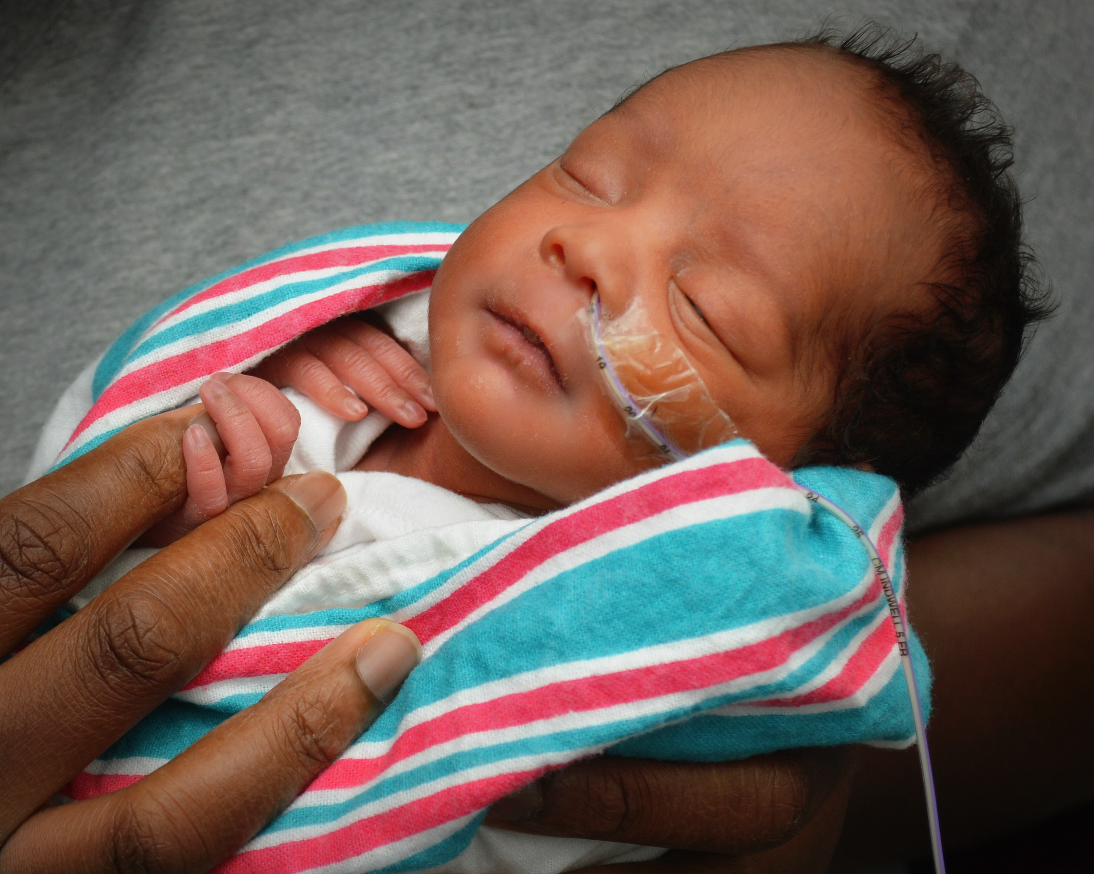
Significant risk adjustment for the preterm infant
↓ Necrotizing enterocolitis in a dose-dependent manner
  49% ↓ any human milk vs. exclusive formula
  47% ↓ higher vs. lower human milk intake
↓ Late onset sepsis in a dose-dependent manner
  29% ↓ higher vs. lower human milk intake
↓ Severe retinopathy of prematurity
  ↓ 77% exclusive human milk vs. exclusive formula
Miller J et al 2018

Slide 25
Pasteurized donor human milk decreases risk for NEC
Risk | Risk with formula | Number of participants (studies) | Certainty of the evidence (GRADE)
 | Relative effect (95% Confidence Interval)
Formula instead of PDHM increases risk of NEC | 1.87 (1.23 to 2.85) | 1675 (9 studies) | moderate
Quigley et al 2019

Slide 26
Difference between maternal and donor milk in microbial diversity
Ford et al 2019
Kumbhare SV et al 2022

Slide 27
Extremely Preterm Infant NEC and Survival Improve Proportional to Maternal Milk Intake
Meinzen-Derr et al 2009

Slide 28
When is it safe to feed human milk? First day?
Hamilton et al 2014

Slide 29
When not to feed human milk? How is feeding intolerance defined?
Distended, glistening, tight, dusky abdomen with bilious emesis and hematochezia?
Abdominal girth is not a reliable measure of feed tolerance
Studies do not demonstrate association with clinical outcomes
May vary by 3.5 cm during one feeding cycle in normal preterm infant
More emesis when not checking residuals?
Preterm infants with retrograde motility,
so green is not as helpful.
Bloody emesis/residuals is predictive of NEC
Isolated hematochezia
Potential for milk protein
Intolerance?
Bhatia P et al 1990; Johnson TS et al 1998; Bertino E et al 2009; Weeks CL et al 2021

Slide 30
When is not feeding (NPO) more beneficial than exposing to human milk?
NICU Culture
Promotion of Feeding
Achieved with protocols for
  Feed initiation
  Feed advancement
  Feeding intolerance
  diagnosis/assessment
Fear of Feeding

Slide 31
To Feed Maternal Milk Must Establish Maternal Milk Supply
Evidence based methods
Pump early (by 6 hours) and often
Hand expression
Skin-to-skin time
Problem solving with lactation specialists
  Comfort
    Including proper phalange fit
  Hospital grade pump
Parker et al 2020
Parker L et al 2020; Morton J et al 2009; Furman L et al 2002; Hallowell SG et al 2016; Casavant SG et al 2015; Fewtrell MS et al 2016

Slide 32
Human Milk Nutrition for Very Preterm Infants- the Mismatch
Nutrient | Very preterm infant daily need/kg | Human milk delivery (150 mL/kg/day) | Human milk delivery (200-300 mL/kg/day)
Energy, kcal | 110-130 | 98-147 | 130-294
Protein, g | 3.5-4.5 | 1-3.5 | 1.3-7
Calcium, mmol (mg) | 3-5.5 (120-220) | 1 (40) | 1.3-2 (52-80)
Phosphorus, mmol (mg) | 2.3-3.9 (70-120) | 0.7 (22) | 0.9-1.4 (29-44)
Sodium, iron, zinc, vitamins including vitamin D also mismatched need compared to intake
Need supplementation of energy, protein, calcium, phosphorus, micronutrients, and vitamins
Goldberg et al 2018; Arslanoglu S et al 2019; Taylor SN 2021 in Nutritional Care of the Preterm Infant

Slide 33
Very preterm infant parenteral vs enteral nutrition topics covered
Start parenteral nutrition and enteral feeds in the first day
Parenteral nutrition
  Amino acids: start ≤3g/kg/day and advance to 3.5 g/kg/day
  Phosphorus: start 1 mmol/kg/day with a 0.8-1:1 Ca:P ratio and increase to 1.5-2 mmol/kg/day with a 1-1.3:1 Ca:P ratio
Enteral nutrition
  Prioritize maternal milk
    Dose dependent decrease in risk for NEC, sepsis, severe ROP
    Provide the tools and support to obtain maternal milk
  Donor milk when maternal milk not available to decrease risk of NEC
  Provide 110-130 kcal/kg/day, 3-3.5 g/kg/day protein, extra calcium/phosphorus/sodium/zinc/iron/vitamins especially vitamin D

