Slide 2
Faculty
Brenda B. Poindexter, MD, MS
Chief, Division of Neonatology, Children’s Healthcare of Atlanta
Marcus Professor of Pediatrics, Emory University School of Medicine

Slide 3
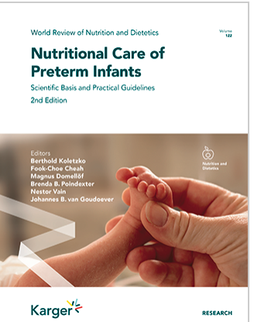
Disclosure
Brenda Poindexter has documented no financial relationships to disclose or conflicts of interest (COIs) to resolve and has documented this presentation will not involve discussion of unapproved or off-label, experimental or investigational use.
Special thanks to Barbara Cormack and Frank Bloomfield – my co-authors for a chapter in the 2nd Edition of Nutritional Care of Preterm Infants on this topic

Slide 4
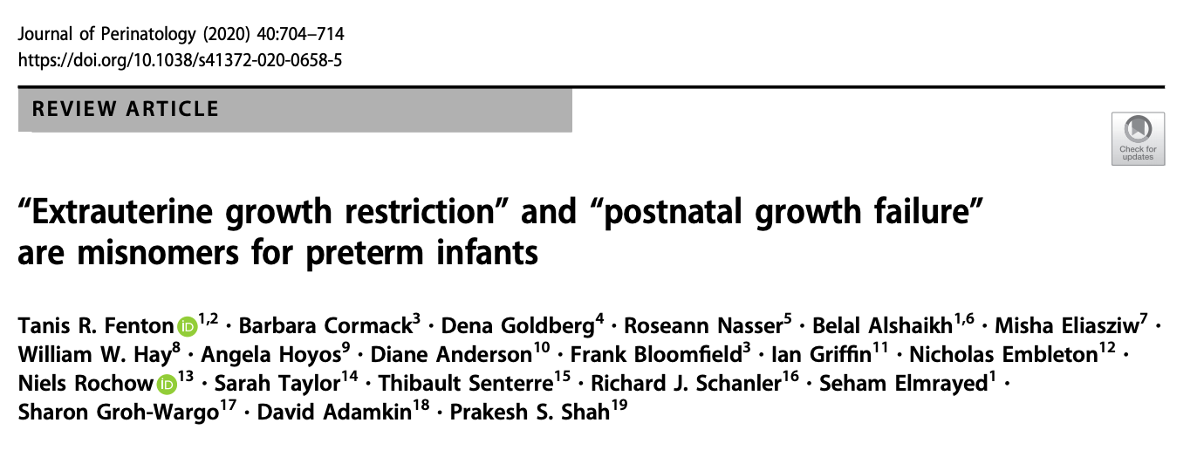
Why is Growth Faltering a Hot Topic?
EUGR/PGF not predictive of adverse outcome
Based only on weight without consideration of head or length growth, proportionality, body composition, or genetic potential
Ignore normal postnatal weight loss
Are usually assessed prior to growth slowly of the reference fetus around 36-40 weeks
Are usually based on an arbitrary statistical growth percentile cut-off

Slide 5
Goals of Early Nutritional Support
Provide nutrients to approximate the rate of growth and composition of weight gain for a normal fetus of the same postmenstrual age
To maintain normal concentrations of blood and tissue nutrients
Optimize neurodevelopment and long-term health outcomes
*achieving these goals requires an understanding of the intrauterine growth rate to be targeted and of the nutrient requirements of extremely premature infants

Slide 6
Target Growth Rate
Weight Interval | g/kg/day
< 1500 g | 17-21
1500-2000 g | 14-17
2000-2500 g | 12-14
2500-3000 g | 10-13
Koletzko, Wieczorek, Domellof, Poindexter, World Rev Nutr Diet 2021

Slide 7
Reference Growth Curves
GA (wks) | Lubchenco (n=5636) | Olsen (n=257,855) | Fenton (n=3,986,456)
22 | - | - | 816
23 | - | 286 | 1682
24 | 24 | 889 | 3012
% of cohort | 0.43% | 0.46% | 0.14%

Slide 8
Phases of Fluid and Nutritional Management
Phase 1 – Transition
First 4-5 days characterized by large transcutaneous water evaporation and renal excretion of large excess of extracellular salt and water
Expected weight loss of 7-12% (~0.8 SD decrease in Z-score)
Phase 2 – Stabilization
Contraction of extracellular fluid complete
Enteral feeding started but not sufficient
Variable length of 5-14 days; complete when BW regained
Phase 3 – Growth
Full enteral feedings tolerated; goal to match intrauterine growth

Slide 9
Defining Intrauterine Growth Restriction
BW < 3rd percentile
OR
Any 3 of the following:
BW <10th percentile
HC <10th percentile
Length <10th percentile
Prenatal diagnosis of fetal growth restriction
Maternal factors such as hypertension or pre-eclampsia
Beune, J Pediatr 2018

Slide 10
Defining Growth Faltering
Most common definition of extrauterine growth restriction and postnatal growth failure = weight <10th percentile at 36 weeks PMA
Experts now calling these terms “misnomers”
(Fenton, J Perinatol 2020)
Physiologic weight loss that occurs from extracellular fluid contraction is ~0.8 Z-score decrease in weight, yet most studies of postnatal growth trajectories of VLBW and ELBW infants report much greater decline in weight Z-score in the first 2-3 weeks after birth (Cole, Arch Dis Child Fetal Neonatal Ed 2014)
Most longitudinal studies report greater decreases in length and HC Z-scores

Slide 11
A Tale of Two Infants – 24^{0/7} wks
 | Birth | 1 week | 36 wks PMA
Wt %tile Z-score | 580 g 25th -0.68 | 550 g 7th -1.44 | 2150g 9th -1.34
Wt %tile Z-score | 720 g 74th 0.65 | 710 g 41st -0.24 | 2150g 9th -1.34
A
B
Chou, J Med Internet Res 2020
peditools.org

Slide 12
Take-home Point
Growth faltering describes a change in growth trajectory, not a position on a growth chart at any given point in time

Slide 13
Prevention is the Best Strategy
Early parenteral and enteral nutrition
Early fortification of human milk
Transition period from parenteral to enteral nutrition
Standardized Feeding Protocols

Slide 14
Parenteral Amino Acids Minimize Protein Losses in ELBW Infants
Denne, J Clin Invest 1996
Poindexter, Am J Physiol 2001

Slide 15
Significance of Early Protein Intake
Early protein (and energy) deficits are difficult to recoup and are associated with postnatal growth faltering (Embleton, Pediatrics 1997)
Early deficiencies in protein intake contribute to poor growth outcomes (Berry, Pediatrics 1997)
Early amino acids improve growth outcomes at 36 weeks PMA (Poindexter, J Pediatr 2006)
Positive correlation between protein/energy intake in the first week of life and Bayley MDI at 18 months corrected age in ELBW infants (Stephens, Pediatrics 2009)

Slide 16
Early Parenteral Nutrition
PN should be started from the first hours of birth with at least 5.8 g/kg of glucose, 1.5 g/kg AA and less than 2 g/kg lipids
Target PN intakes of 3.5 g/kg AA, up to 14 g/kg glucose and up to 4 g/kg of lipids if tolerated
*No data to support slow advancement of AAs
Do not taper parenteral amino acids before an enteral intake of at least 75 mL/kg has been reached
Carnielli, World Rev Nutr Diet 2021

Slide 17
Early Enteral Nutrition
Early enteral feedings recommended – reduced days to regain BW, days to reach full enteral feedings (Tyson & Kennedy, Cochrane Database Syst Rev 2009)
Early progressive feeding increases the number of full enteral feeding days in the first month and reduced days on PN (Salas, Am J Clin Nutr 2018)
Faster rates of advancement (30 mL/kg) of enteral feeding does not affect risk of survival without moderate or severe neurodevelopmental impairment (Dorling, NEJM 2019)

Slide 18
Composition of Human Milk
Makers of HMF assume 1.4-1.6 g/dL – and do not account for the decrease in protein over time

- - Donor milk - - - - - - - - - - - - - - - - - - - - - - - - - - - - - - -
Weeks of lactation

Slide 19
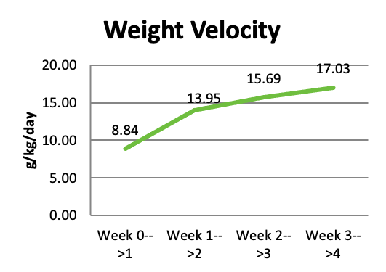
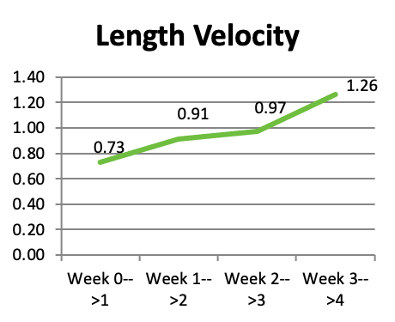
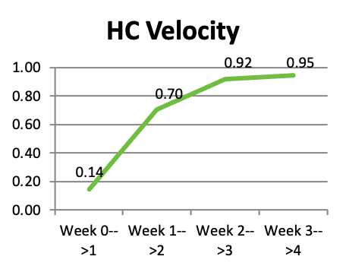
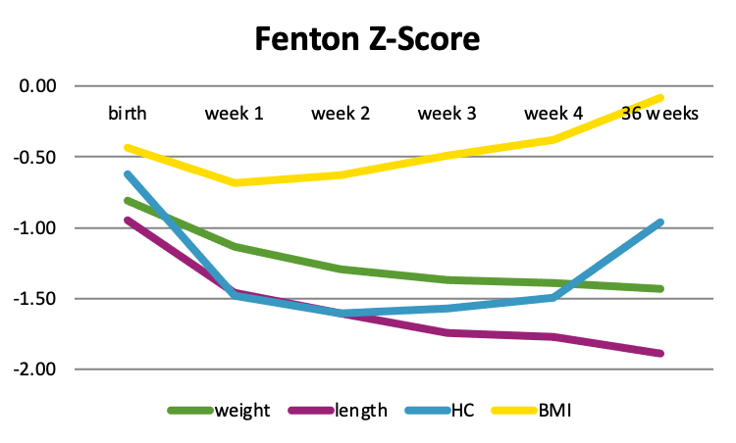
Donor Milk and Growth
Ting Ting Fu, MD
Fu, Nutrients 2019

Slide 20
Transition from PN to Enteral Nutrition
Figure courtesy of Barbara Cormack

Slide 21
Standardized Feeding Protocols
Consensus and evidence-based strategies for the provision of early parenteral and enteral nutrition
Standardized feeding protocols mediate the impact of perceived severity of illness on decisions related to nutritional support
Improved outcomes following implementation include a reduction in time to reach full enteral feedings, decrease in number of days on PN, improved postnatal growth, and reduction in NEC (Patole, Arch Dis Child Fetal Neonatal Ed 2005; McCallie, J Perinatol 2011)

Slide 22
Monitoring for Growth Faltering
Measure weight a minimum of 2-3 times/week
Measure length (with length board) and HC weekly
Convert measurements to Z-scores to monitor change
> 2.0 change in Z-score consistent with severe malnutrition
Definitions of growth faltering require validation and future studies to determine the target growth pattern to achieve best neurodevelopmental and other long-term outcomes

Slide 23
Causes of Growth Faltering
Comorbidities of prematurity associated with poor growth outcomes (NEC, IP, BPD, severe ROP)
Therapies such as fluid restriction, diuretics, and systemic steroids
Inadequate protein intake (may have low BUN)
Sodium depletion (especially with high losses such as ostomy output) – suspect if urine Na <20
Zinc deficiency (<10 µmol/L)
Fat or carbohydrate malabsorption
Anemia
Increased energy requirement (especially congenital heart disease with left to right shunt)

Slide 24
Sodium Supplementation to Improve Growth
RCT of early sodium supplementation (4 meq/kg/d) from day 7 to 35 showed less hyponatremia episodes and greater weight gain (27 vs 23 g/kg/d) in preterm infants (n=53; avg GA 28 wks)
Using algorithm for sodium supplementation based on urine sodium concentrations historical control studies have demonstrated improved weight Z-scores (0.32 vs -0.01) (ongoing RCT in preterm infants)
Isemann, J Parenter Enteral Nutr 2016
Segar, Am J Perinatol 2018 (NCT03889197)
Butterworth, J Pediatr. Surg 2014

Slide 25
Intervention Strategies
Higher enteral volumes
Recent RCT of higher (180-200 mL/kg/d) vs standard (140-160 mL/kg/d) feeding volume found improved growth without increase in adverse outcomes (Travers, J Pediatr 2020)
Additional HMF—Once on full volume feedings, increase to 6 packets HMF/100 mL (27 kcal/oz) with suboptimal growth (add 3 mL liquid protein if mostly donor milk or if length faltering)
Liquid protein—especially if receiving donor milk
If 30 kcal/oz recipe needed, add preterm formula or transition to preterm formula (consider stopping donor milk)

Slide 26
Growth and Long-Term Outcomes
Better nutritional support is associated with improved growth and less extrauterine/postnatal growth failure
Improved growth correlates with improved neurodevelopmental outcomes
Linear growth associated with improved neurodevelopment - Increase of 1 Z-score at discharge associated with 8-point increase in language score (Ramel, Neonatology 2012)
Better nutritional support is associated with improved neurodevelopmental outcomes

Slide 27
Key Messages
Growth faltering describes a change in growth trajectory – not a position on a growth chart at any given point in time
Although most VLBW infants are AGA at birth, postnatal growth faltering remains a common complication of preterm birth
A decrease of 0.8 SD in growth parameters over the first few weeks is likely physiologic
Although weight gain is important and simple to measure, proportional gains in linear growth and head circumference are essential to optimize outcomes

Slide 28
Key Messages
Prevention is the ideal, but when growth faltering does occur, prompt recognition, identification of contributing factors, and appropriate interventions are necessary
Future research needed to identify optimal rate of postnatal growth to improve neurodevelopmental outcomes

